Slide 1
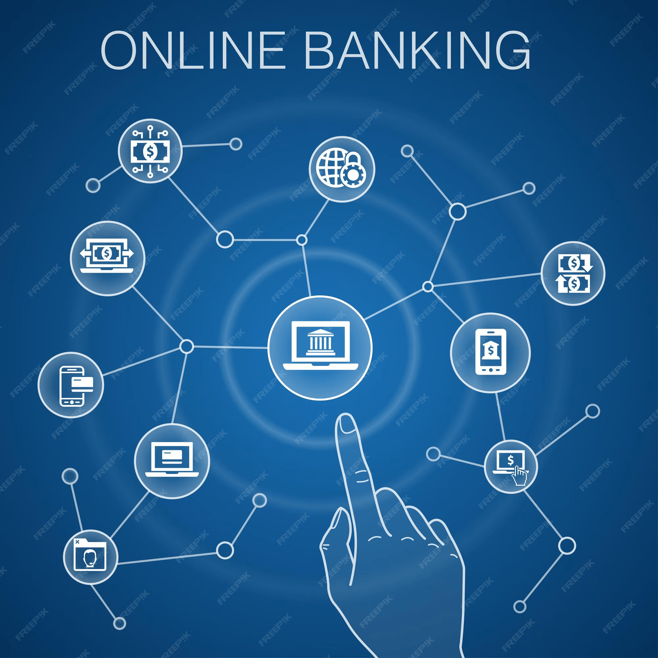

BY
GROUP NUMBER :09

Slide 2
Group Members:
Name:
RITWIK TRIPATHI - 2567382
SAGAM MOUNIKA - 2567022
VISHWA R - 2569262
BOMPELLY VENKATESH - 2567385
DONTHI ARUN - 2569231
GARIMA SHARMA - 2567395
LANKA SAIRAM - 2568596
LIPSA NAYAK - 2569171
MADDIKE THIRUNATHAREDDY -2566820

Slide 3

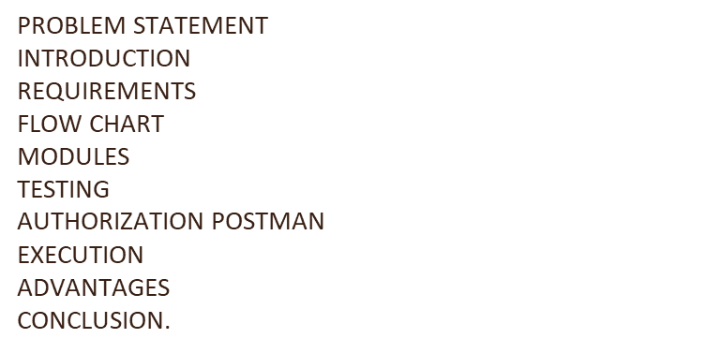
CONTEXT
PROBLEM STATEMENT
INTRODUCTION
REQUIREMENTS
CLASS DIAGRAM
USE CASE DIAGRAM
SEQUENCE DIAGRAM
MODULES
TESTING
AUTHORIZATION POSTMAN
EXECUTION
ADVANTAGES
CONCLUSION.

Slide 4

PROBLEM STATEMENT
people had to deal with inconvenience, long wait times, lots of paperwork, limited bank hours, security worries, and a lack of real-time information when managing their money.

Slide 5
GOAL OF THE PROJECT
The goal of this project is to create a comprehensive online banking portal using Spring Boot, Java, Angular, and Eclipse as the development environment.
The portal should address the following key objectives:
User authentication and Security
Account Management
Transaction Processing and Transaction Tracking
Balance Enquiry
Notifications and Alerts
Administrator Dashboard
User-friendly Interface
Documentation
Scalability

Slide 6

INTRODUCTION
Develop a secure and user-friendly online banking platform that allows customers to conveniently manage their accounts, perform transactions, and access financial services from anywhere.
The system should prioritize data privacy, offer real-time updates, and ensure seamless integration with various devices to enhance the overall banking experience.

Slide 7

TOOLS & TECHNOLOGIES USED
Front-End : Angular
Server-side : Spring Boot , Spring Data JPA, Hibernate
Back-end : MYSQL
Web-Server : Tomcat
Testing : Selenium, Junit, Postman

Slide 8
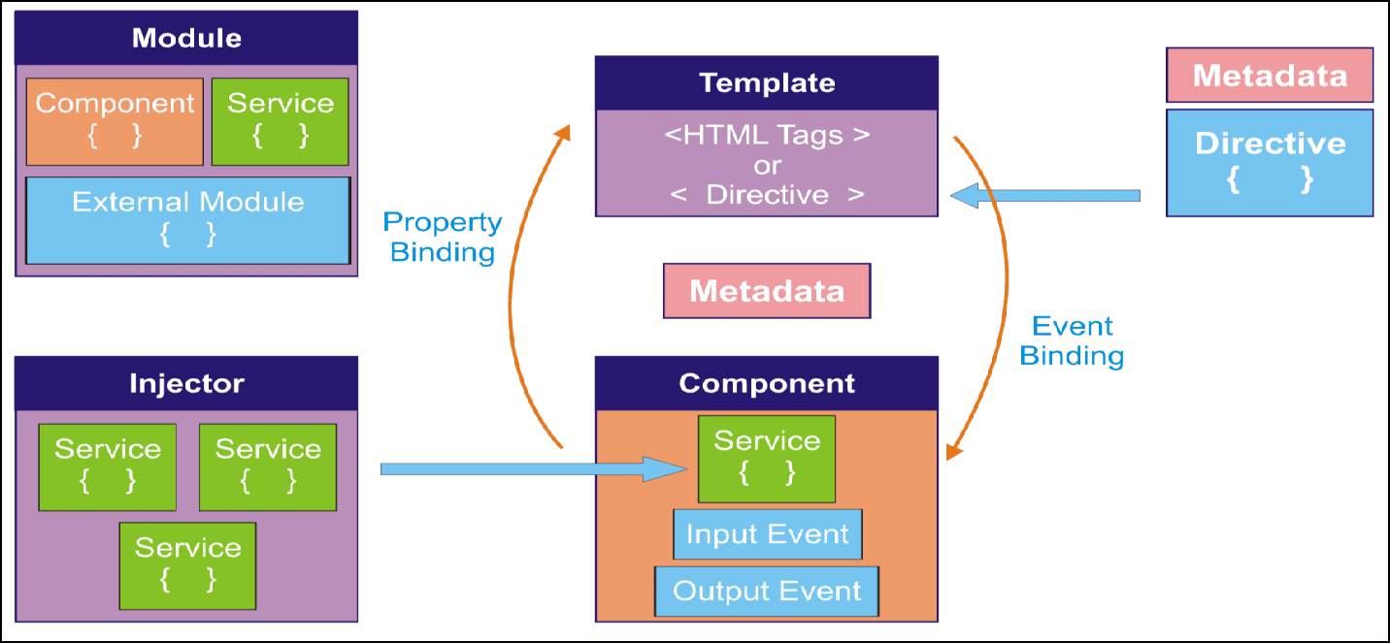
Angular Architecture

Slide 9
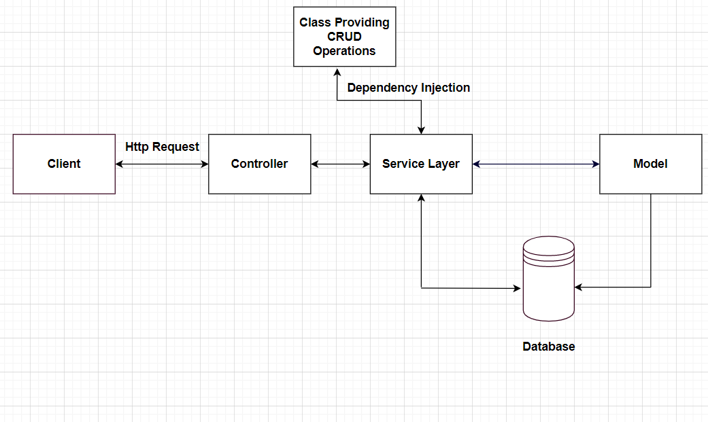
Spring Boot Architecture

Slide 10
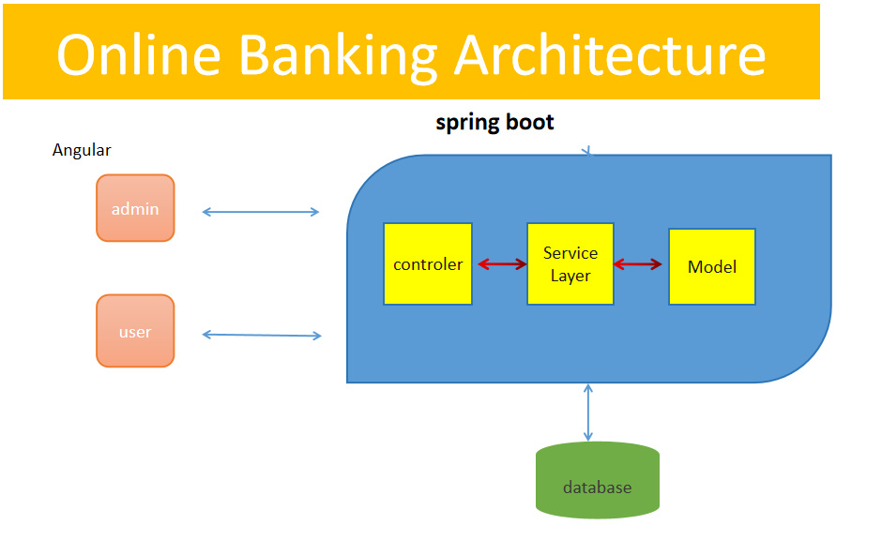

Slide 11
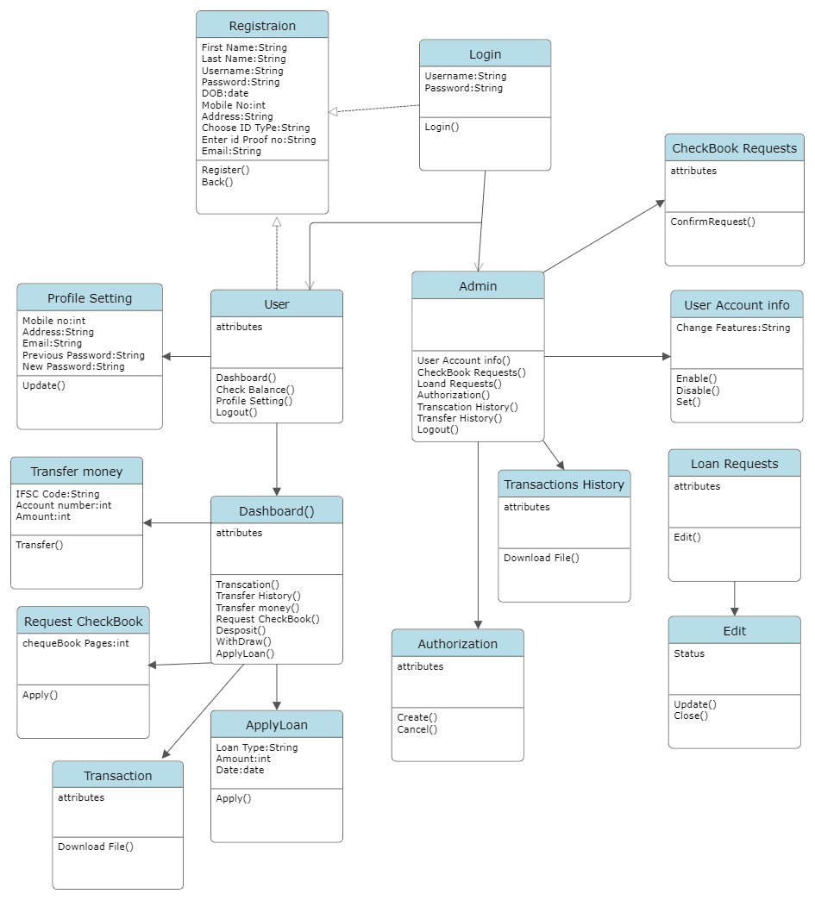
CLASS DIAGRAM:
In software engineering, a class diagram in the Unified Modeling Language
(UML) is a type of static structure diagram that describes the structure of a system by showing the system's classes, their attributes, operations (or methods), and the relationships among the classes.
It explains which class contains information

Slide 12
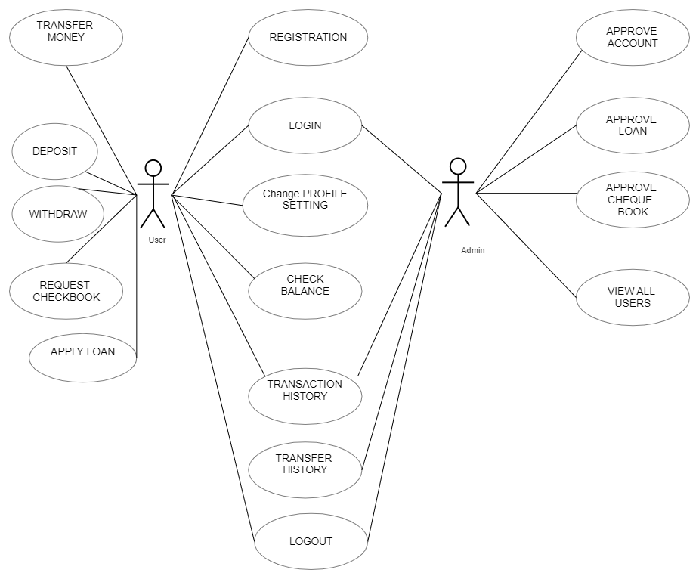
USE CASE DIAGRAM:
The main purpose of a use case diagram is to show what system functions are performed for which actor. Roles of the actors in the system can be depicted. The below diagram consists of user and admin as actor.

Slide 13
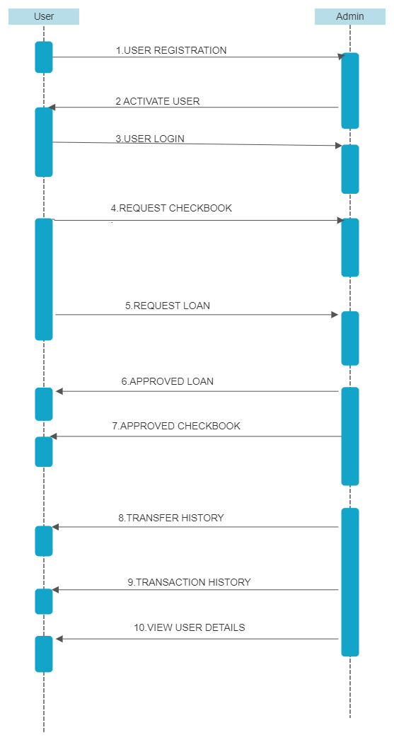
SEQUENCE DIAGRAM
A sequence diagram in Unified Modeling Language (UML) is a kind of interaction diagram that shows how processes operate with one another and in what order.

Slide 14
MODULES
Administrator module
Registration and Login module
Account creation and Authorization module
Deposit module
Withdraw module
Loan request module
Cheque book request module
Transaction module
Transfer module
Testing

Slide 15
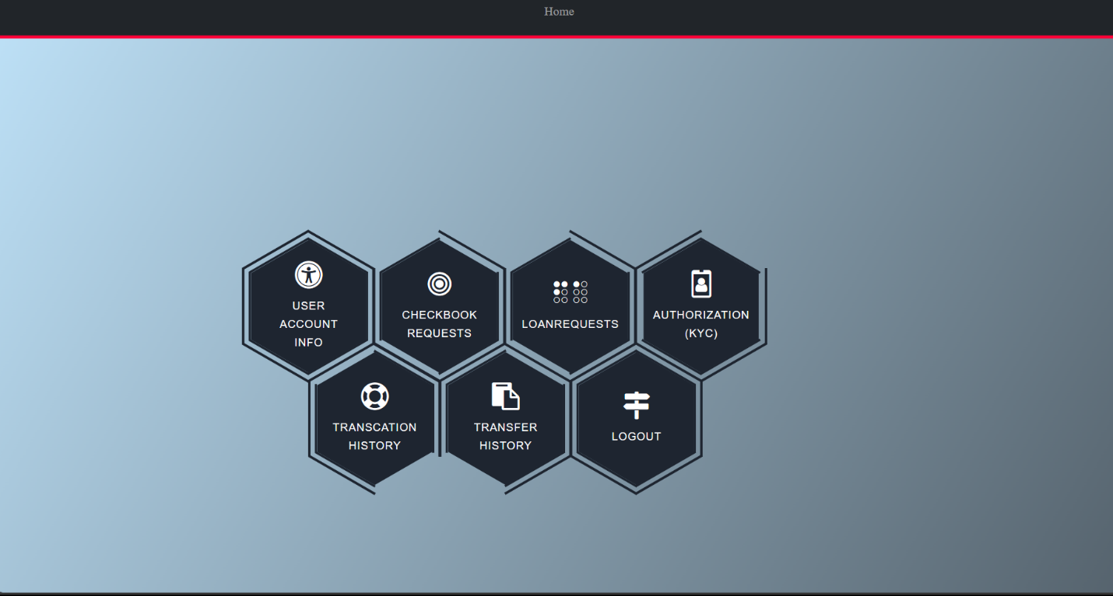
Administrator module
Functions of Admin
Admin can activate/deactivate user account
Admin can block/approve user fund transfer.
Admin can cancel/approve Checkbook and loan request.
Admin can view user transaction history.
Admin can download transaction history.

Slide 16
REGISTRATION AND LOGIN MODULE
User Information Gathering: The module should collect essential user information, such as name, contact details, date of birth etc.
Username and Password Creation: Users should be prompted to create a unique username and a strong, secure password during registration.
Email Verification: Implement an email of an user should be unique.
Document Upload: If required, enable users to upload identification documents securely. This is crucial for identity verification and regulatory compliance.
Validation and Error Handling: Implement validation checks to ensure that user input is accurate and complete.

Slide 17
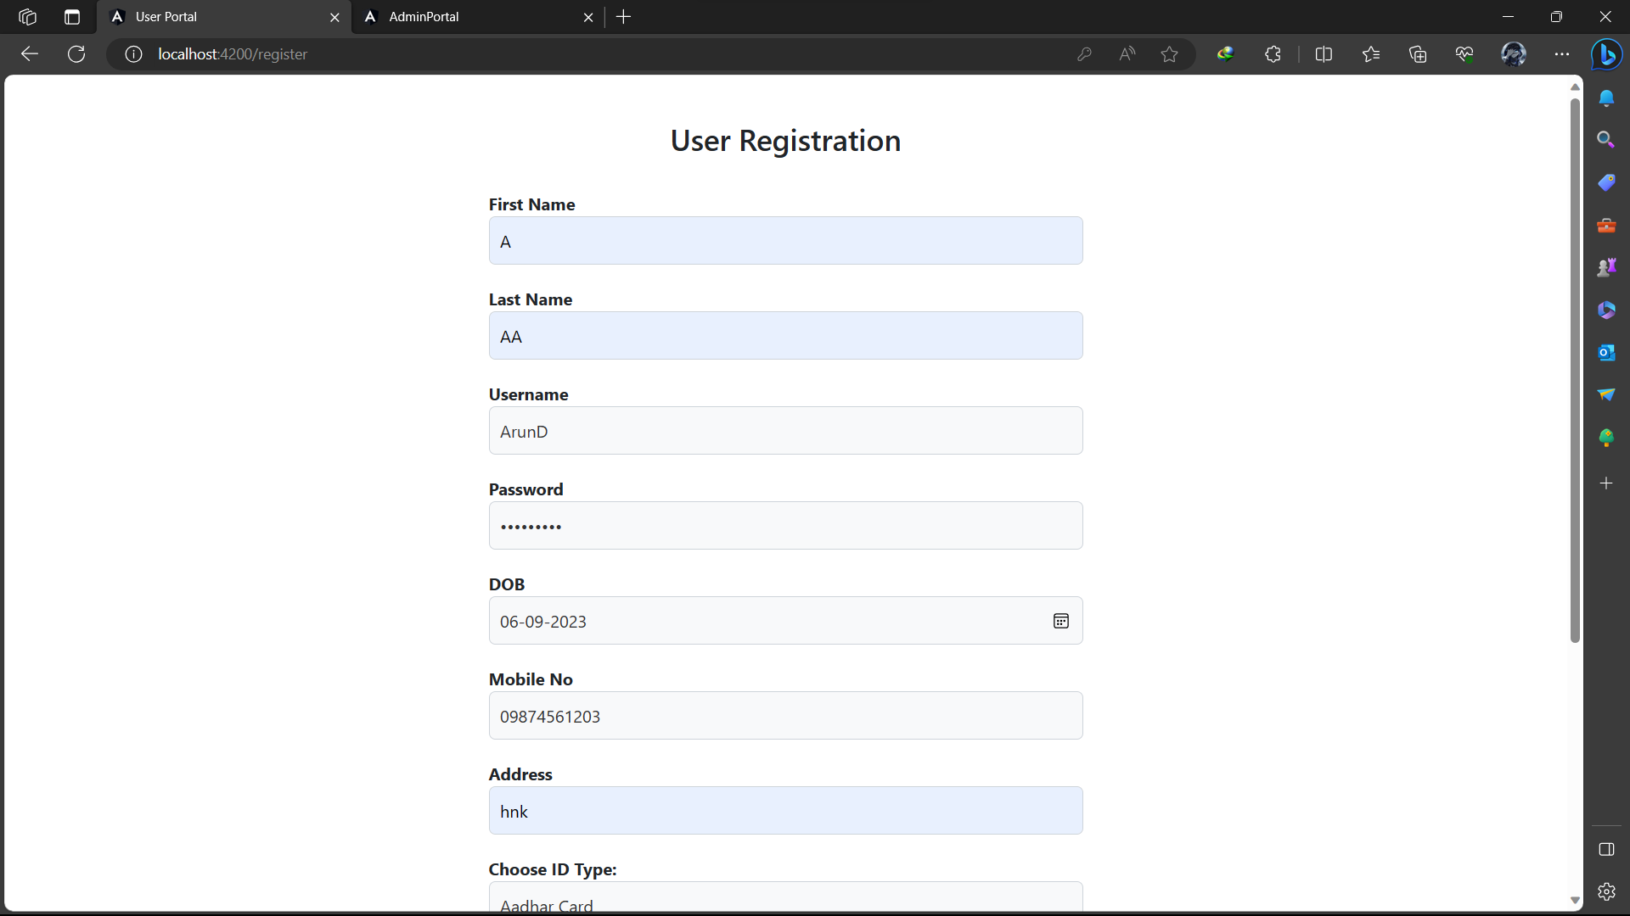
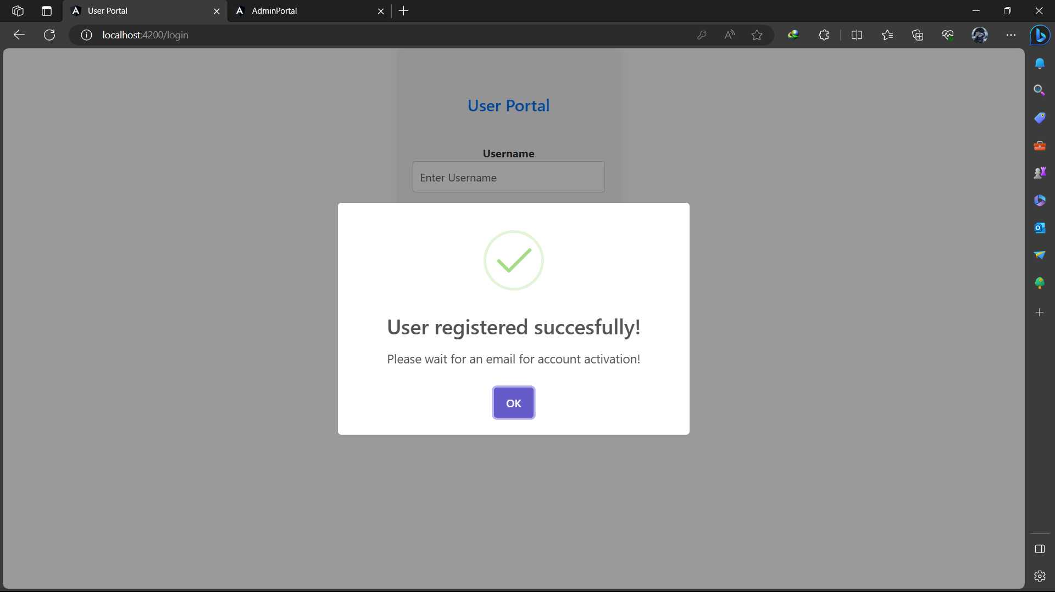

Slide 18
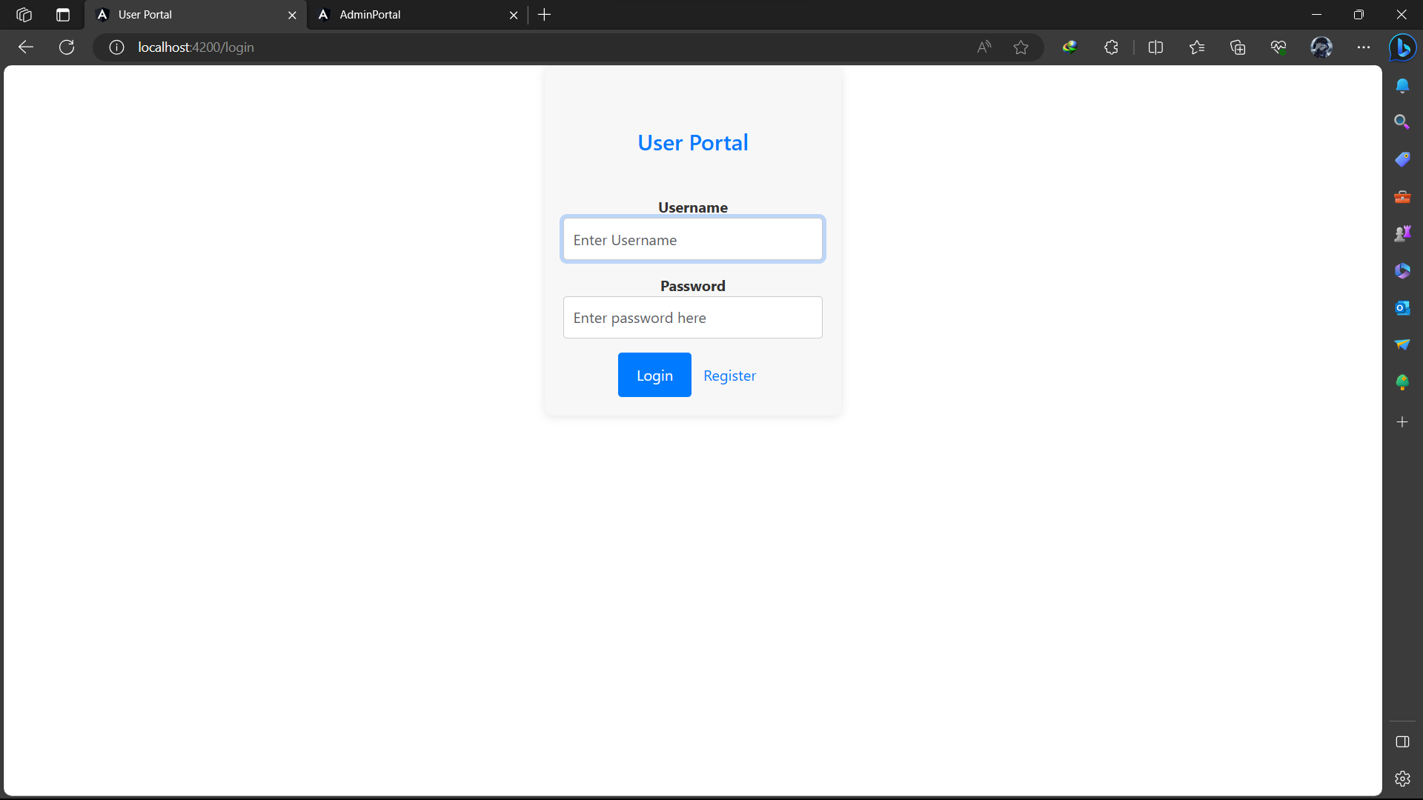

Slide 19
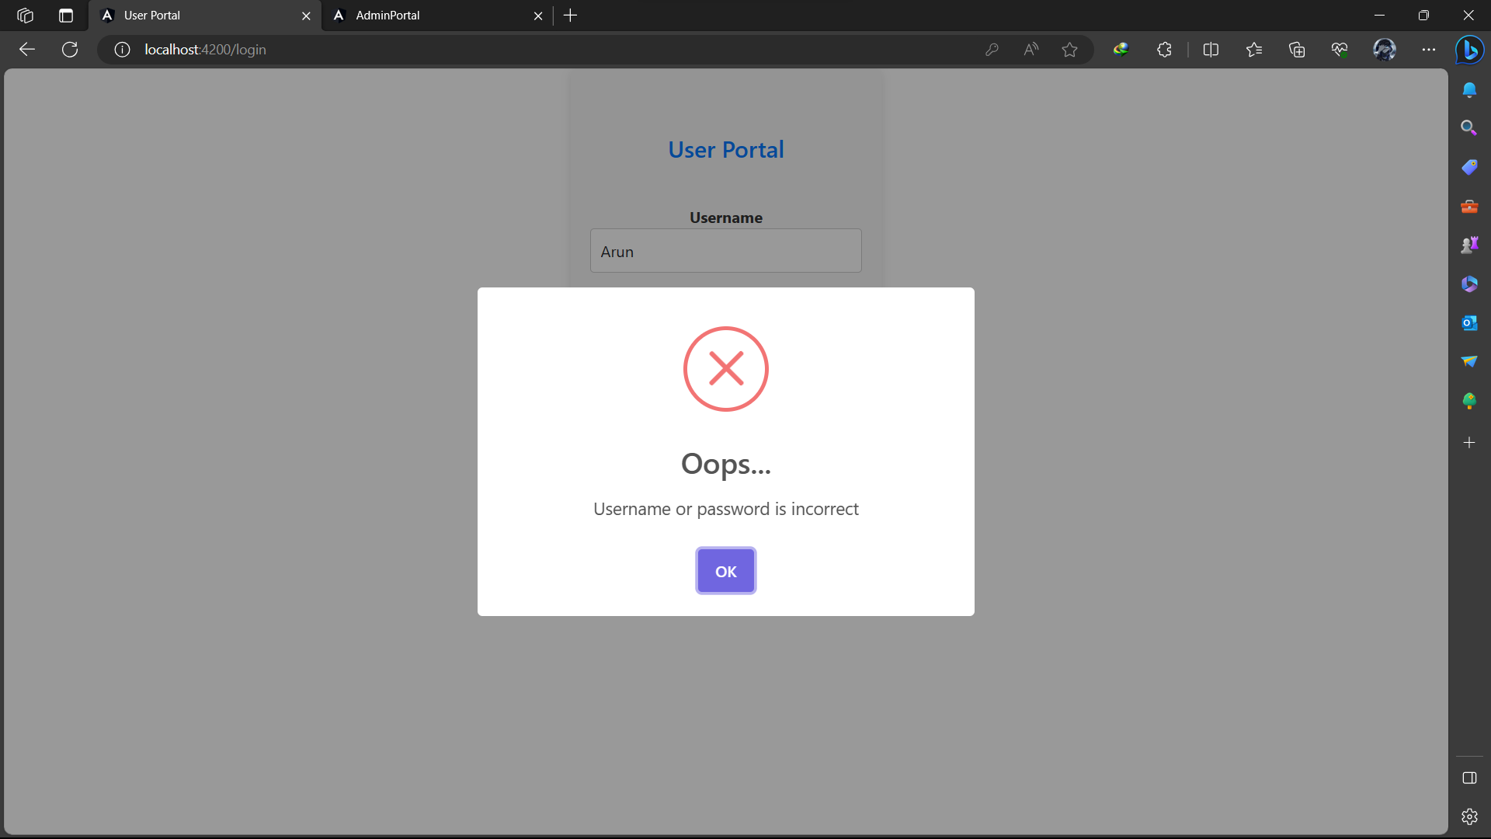
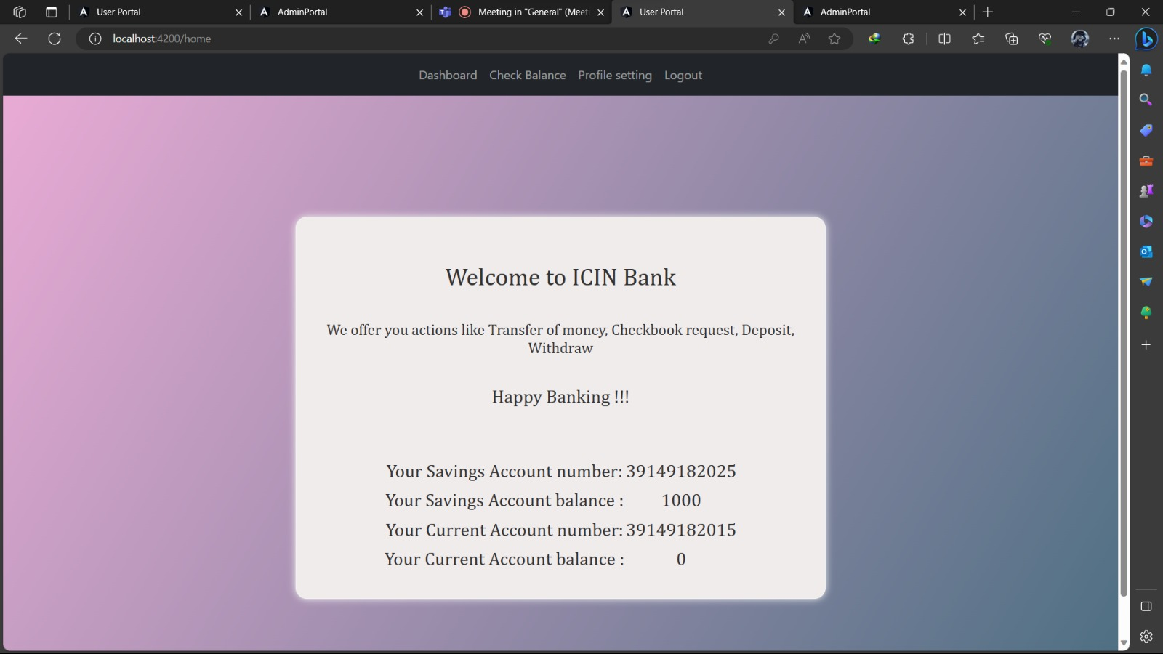

Slide 20
Account creation and Authorization module
User Request Submission: When a user submits a request for account creation, the system should record the request and mark it as "pending approval." This status indicates that the user cannot log in until the request is reviewed and approved by an admin.
Admin Review Interface: This interface should display relevant user information and request details, such as the user's name, email for account creation.
Admin Approval Workflow: Implement a workflow that allows admin users to either approve or reject account creation requests. When the admin approves the request, the system should update the user's status to "active," allowing them to log in. If the request is rejected, user can’t logged in.
Error Handling: When a user attempts to log in before their account creation request is approved, the system should display a clear and user-friendly error message, such as "Admin has not yet approved your account.

Slide 21
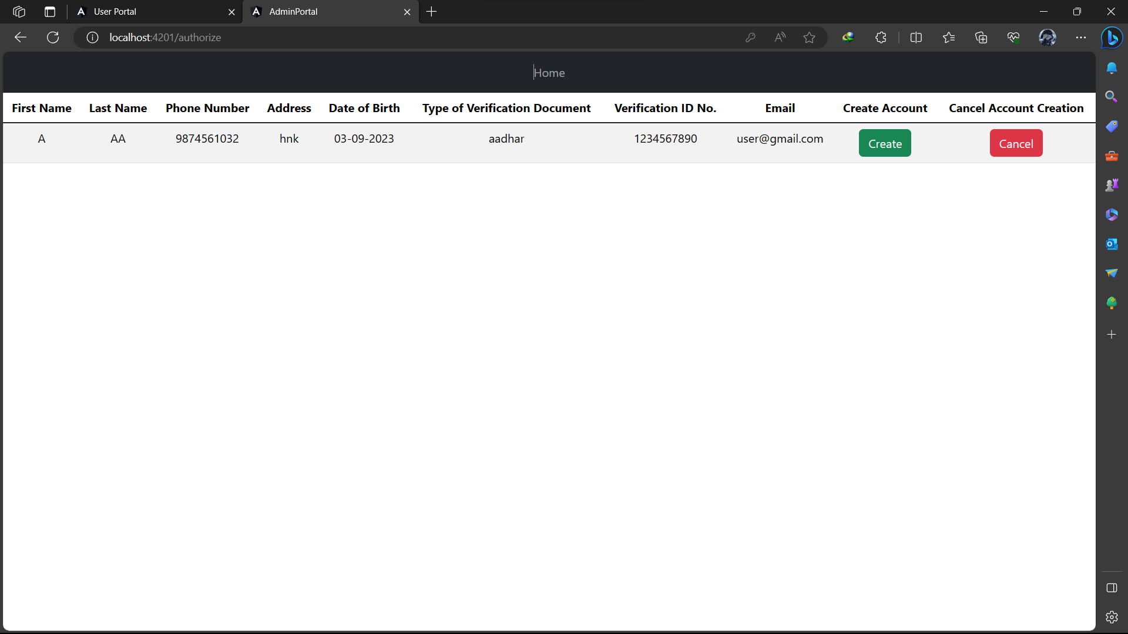
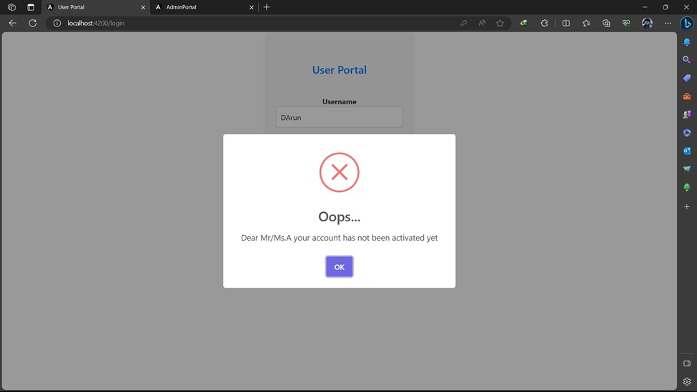

Slide 22
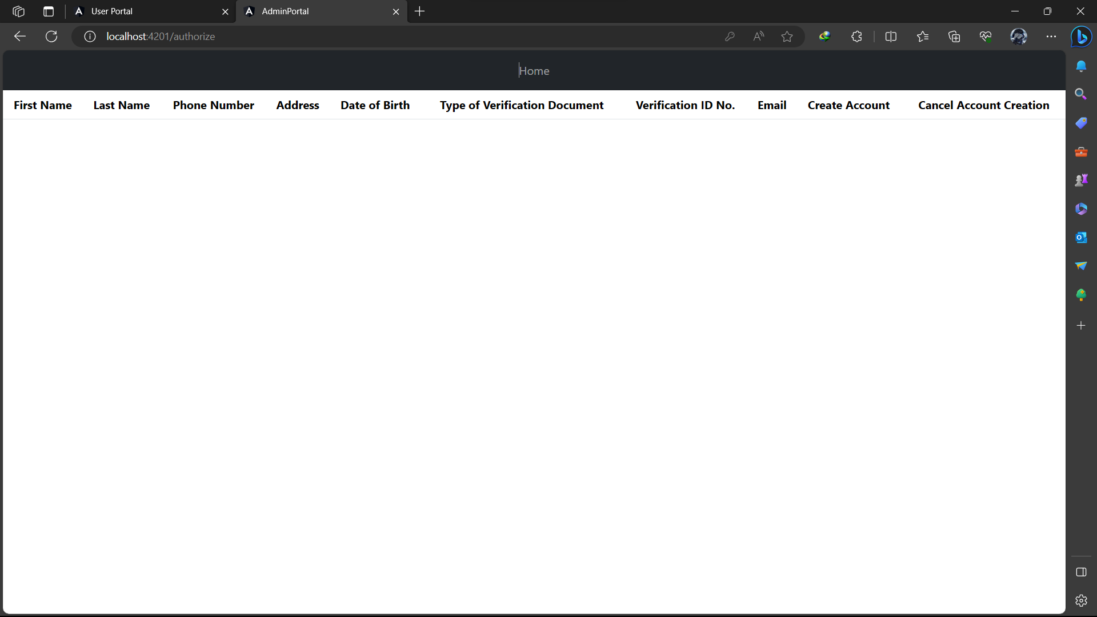

Slide 23
USER ACCOUNT INFO
User Detail Module Overview:
Introduction to the user detail module within the admin panel.
Its role in managing user accounts and permissions.
Primary Functions:
Enabling and disabling user accounts.
Changing user features or permissions.
Benefits:
Improved security and control.
Flexibility in user management.
Enhanced user experience.

Slide 24
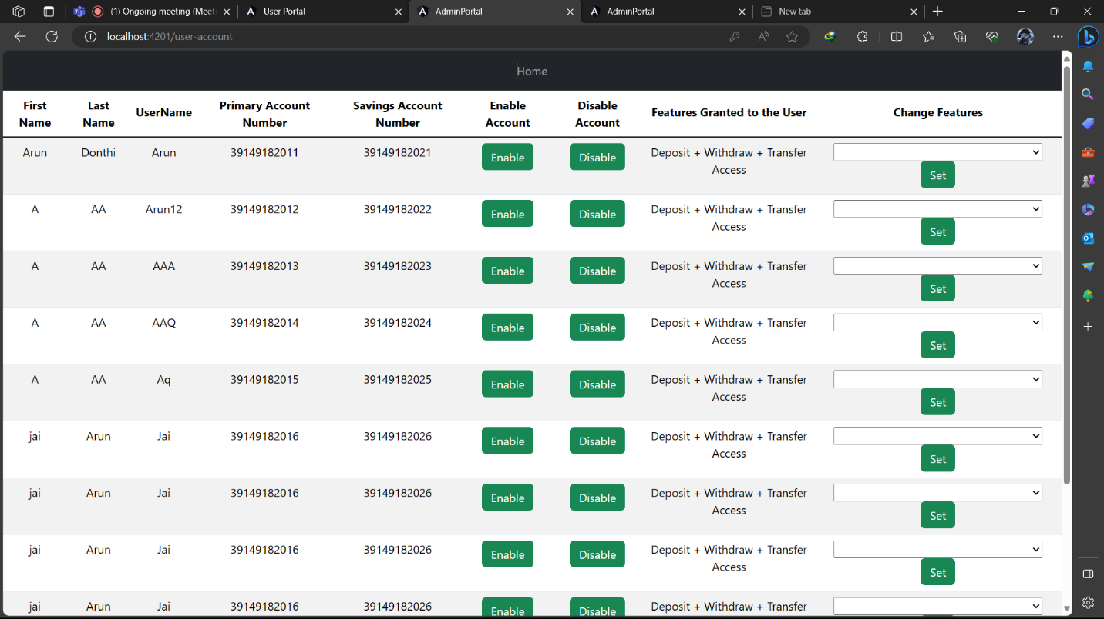

Slide 25
Deposit module
In Deposit module the user can deposit money to the account .
The User need to click on the Deposit option provided in the user portal and needs to enter the amount to be deposited .
The amount he entered will be credited to his account and the same Reflected in Account Balance.

Slide 26
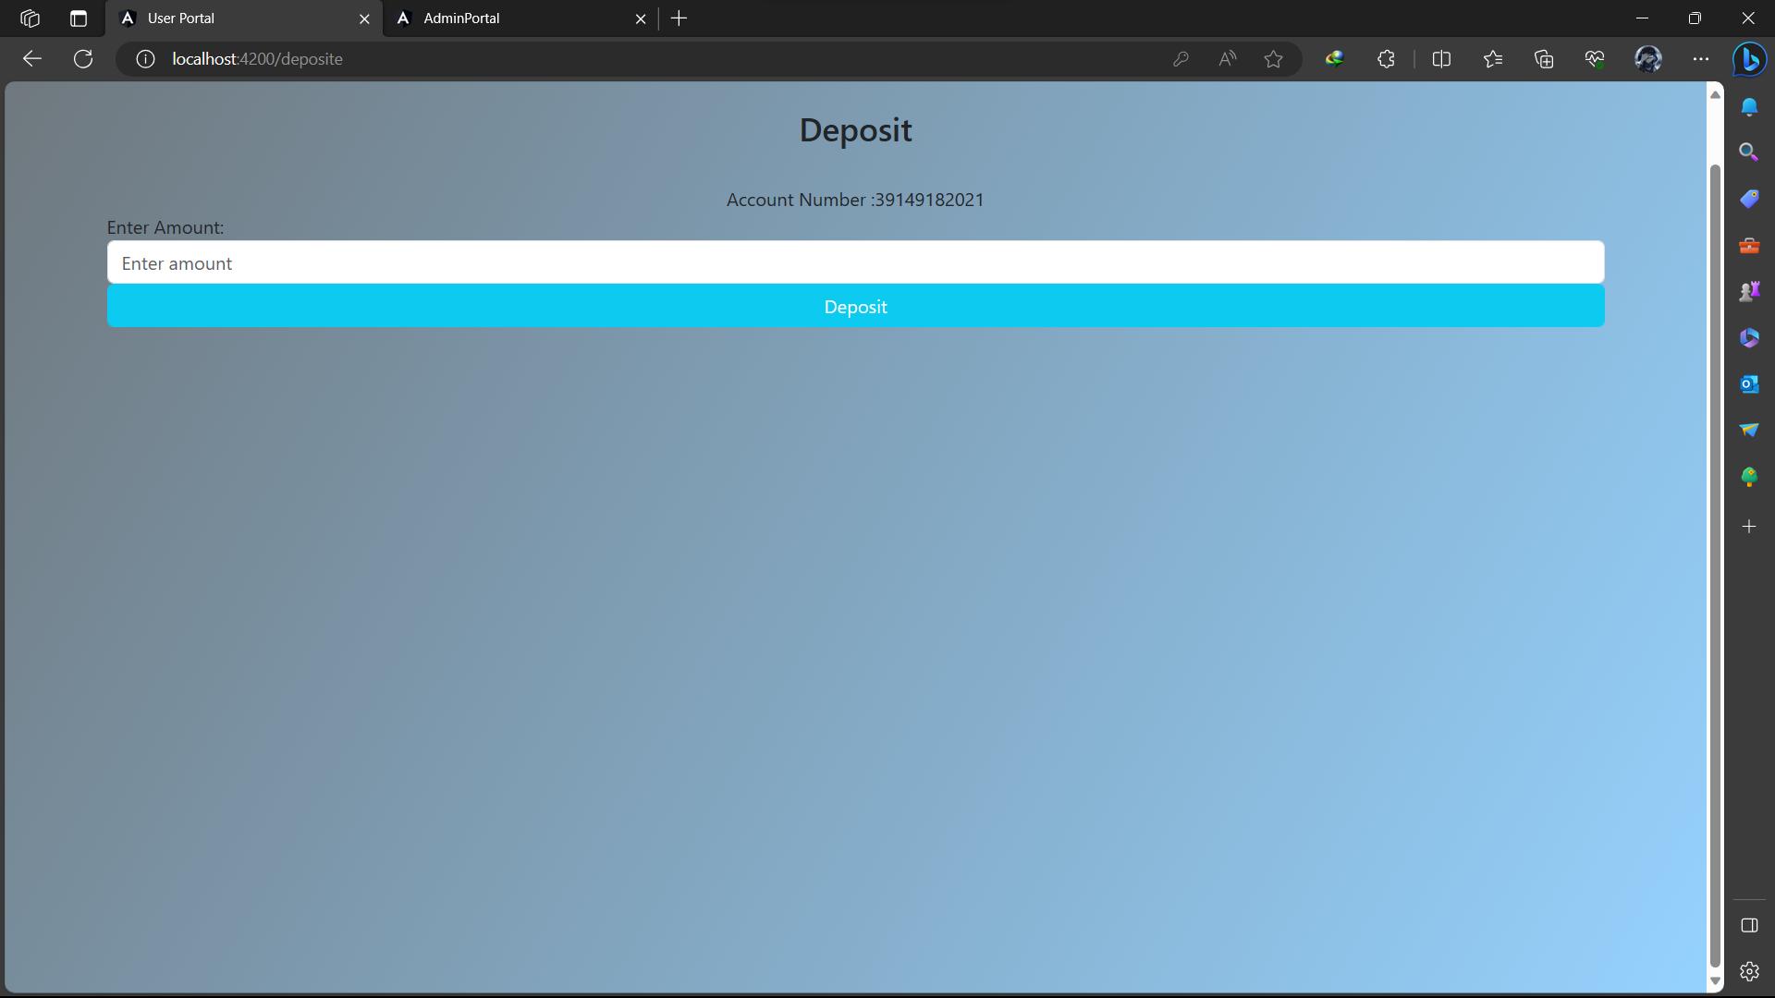
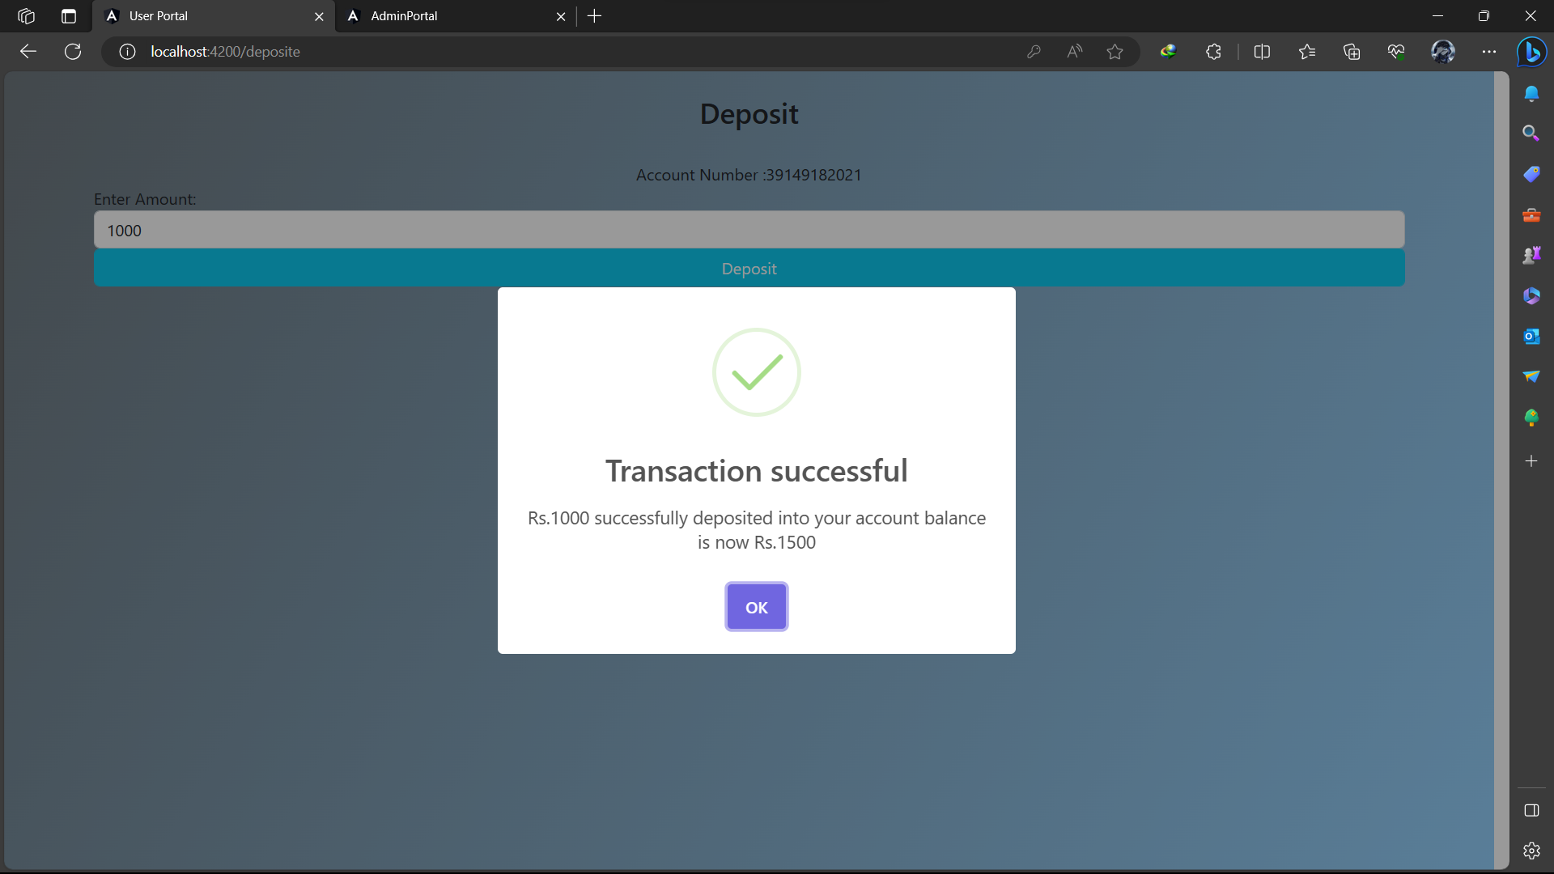

Slide 27
Withdraw module
In withdraw module, the user can withdraw money from the account.
The User need to click on the withdraw option provided in the user portal needs to enter the amount to be withdrawn.
The amount he entered will be debited from his account and Reflected in the Account Balance.
The amount user entered to withdraw must be less than the amount present in the account (Account Balance). (Withdraw <= Balance).

Slide 28
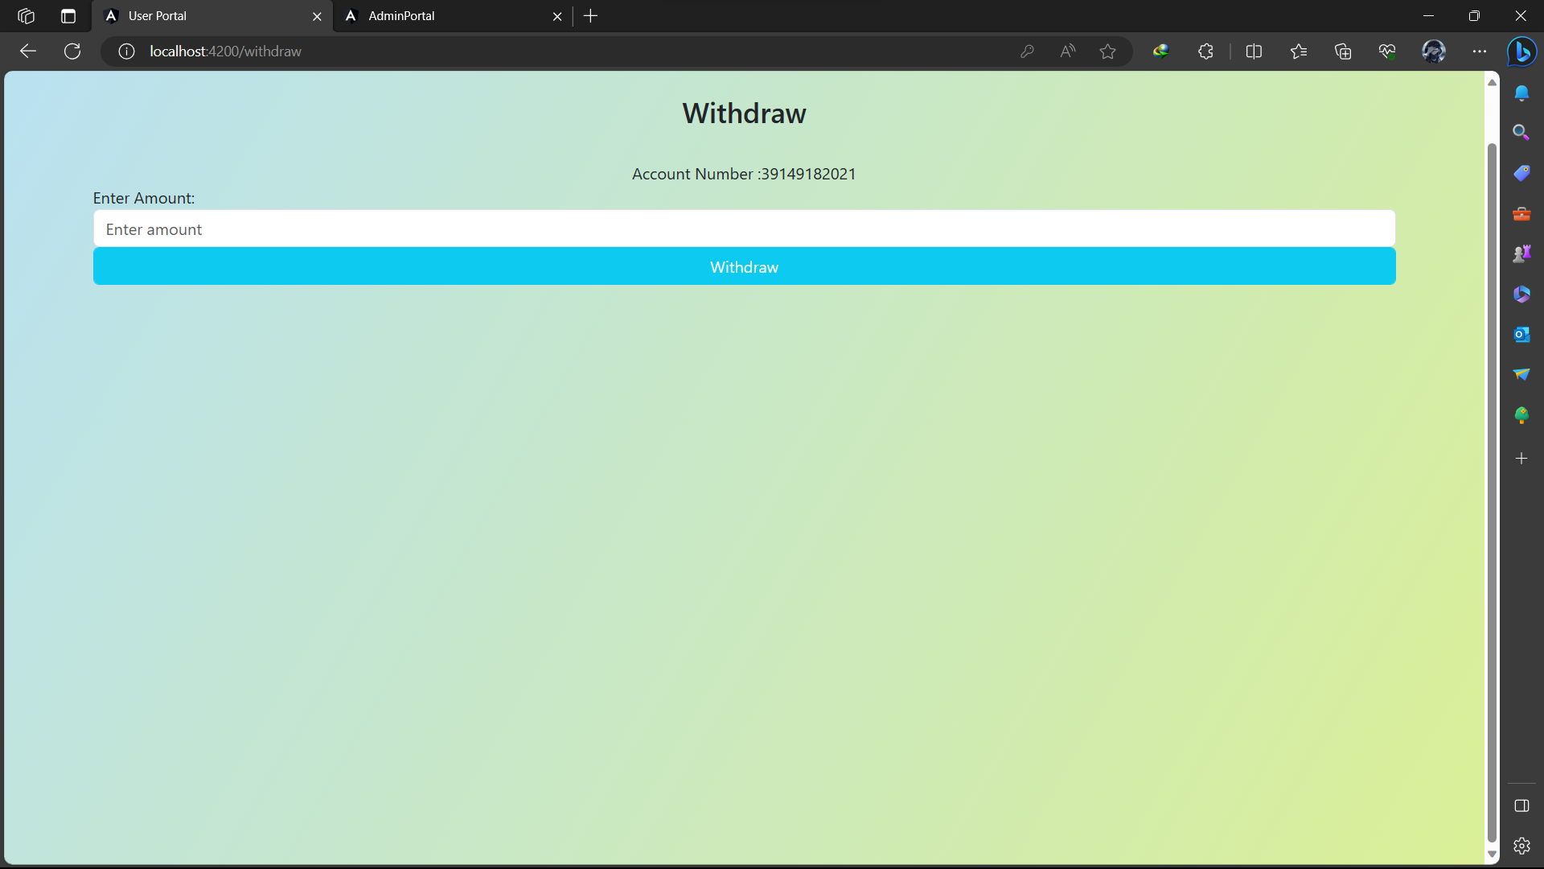

Slide 29
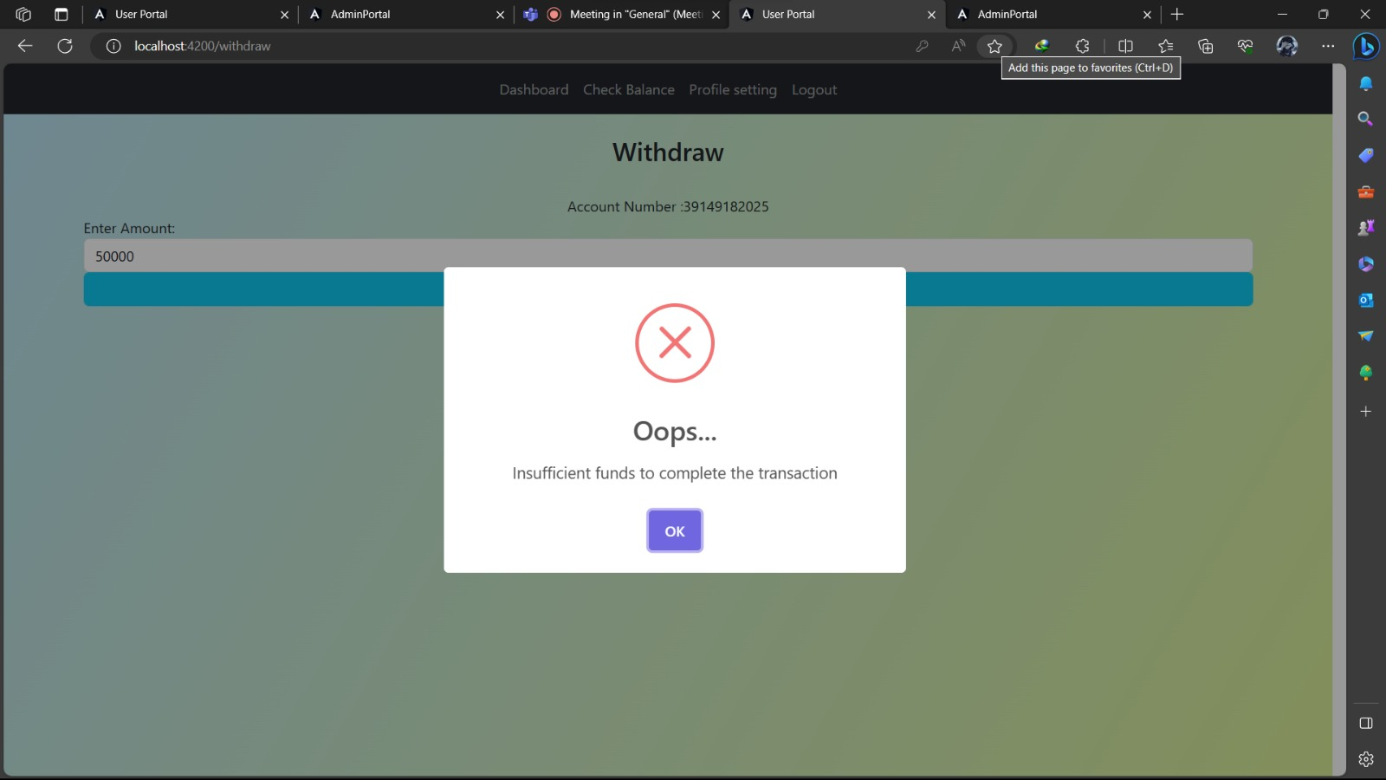
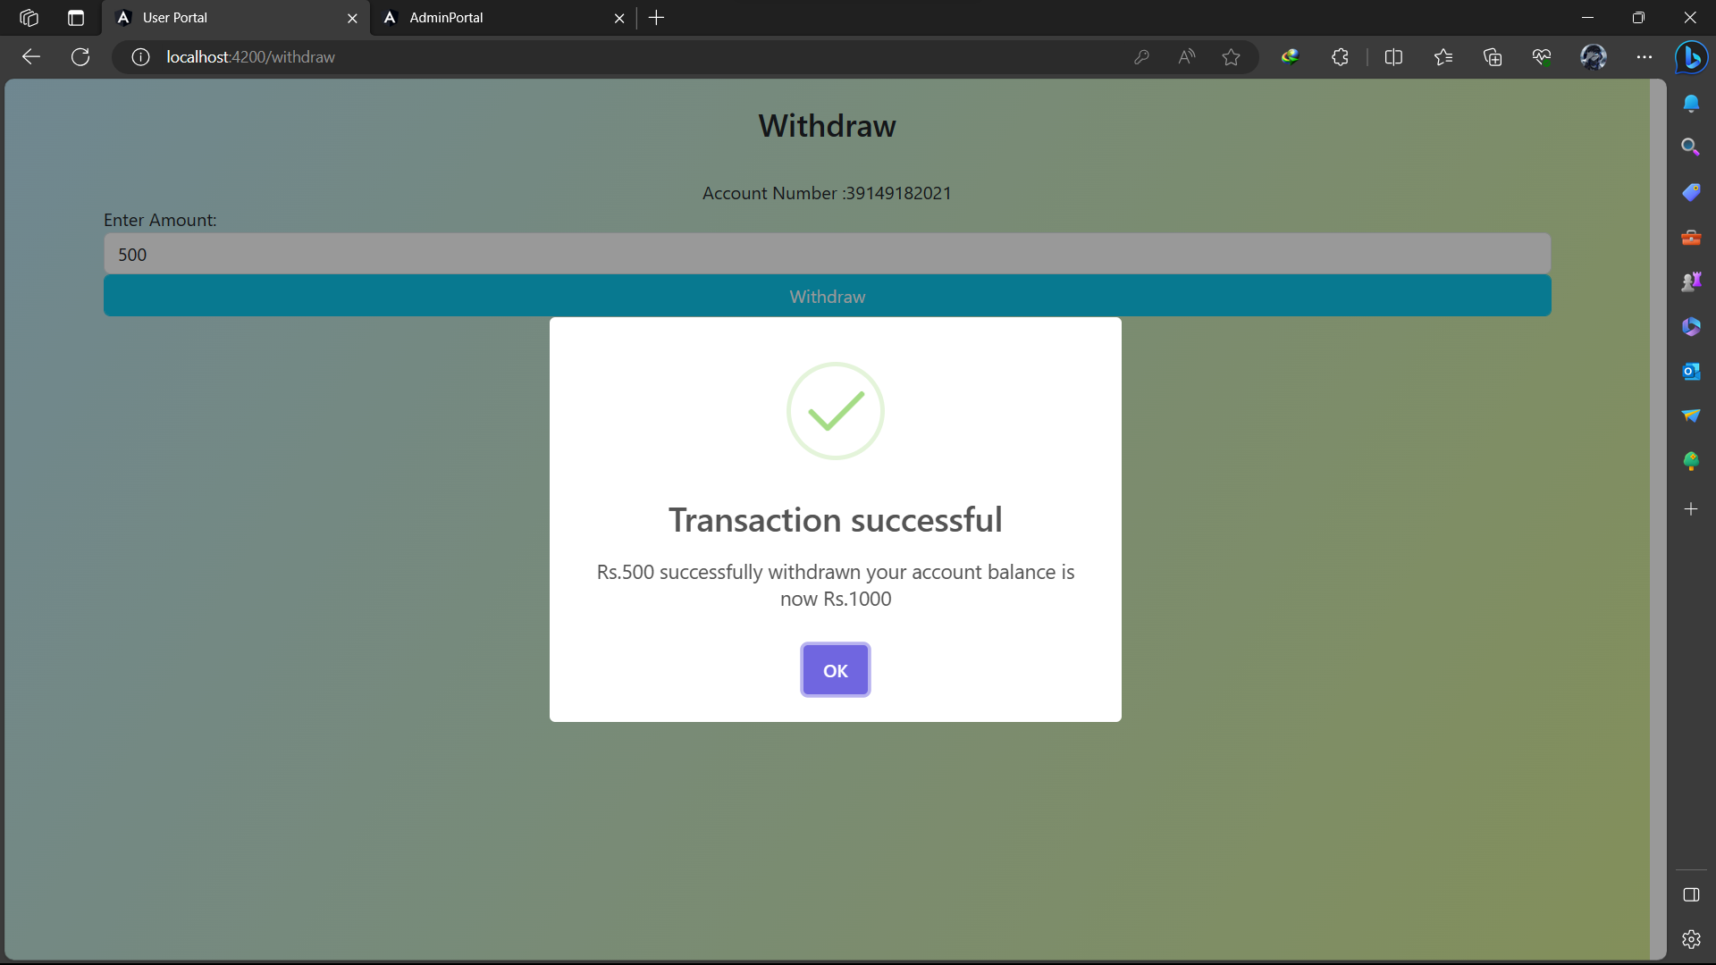

Slide 30
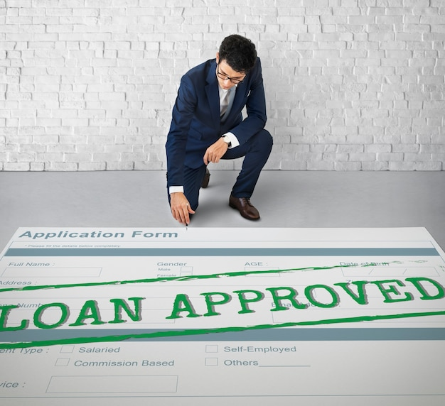
Loan request module
In loan request module the user have to choose which type of loan (Home loan ,Educational loan , etc)and how much amount he is requesting.
The request send to Admin for approval after admin approves the user can take the loan amount

Slide 31
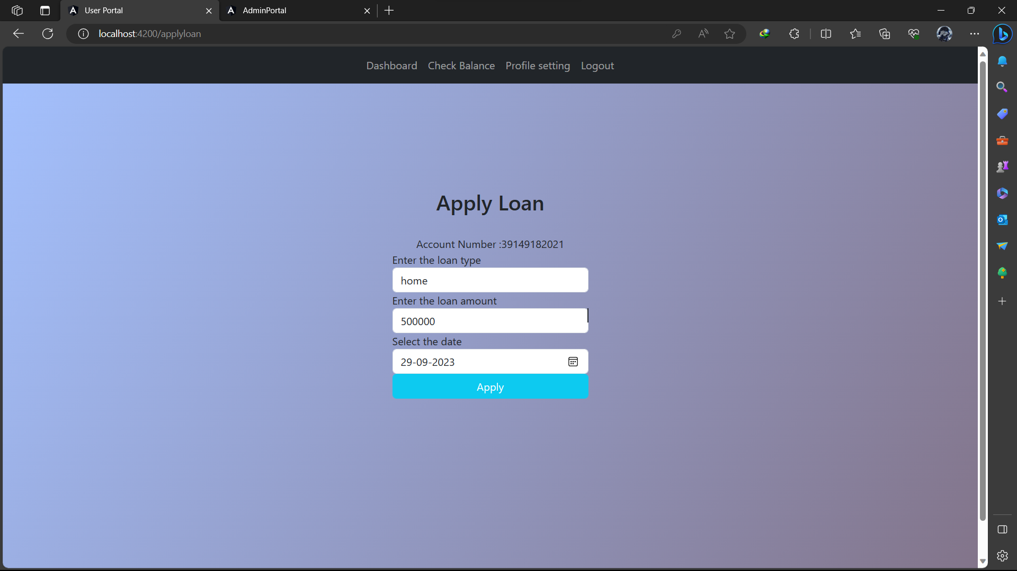
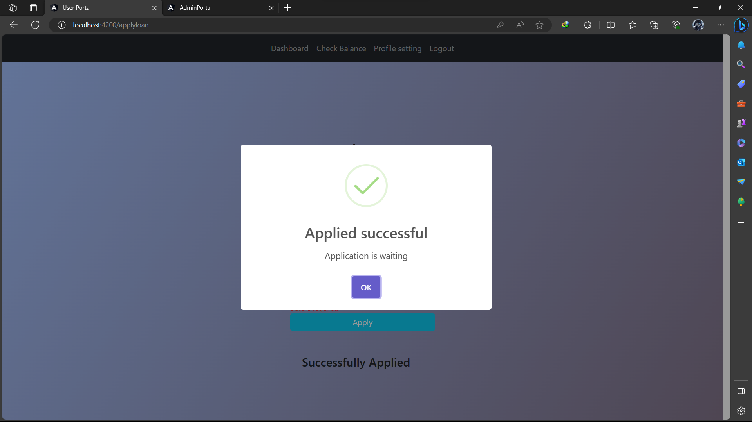

Slide 32
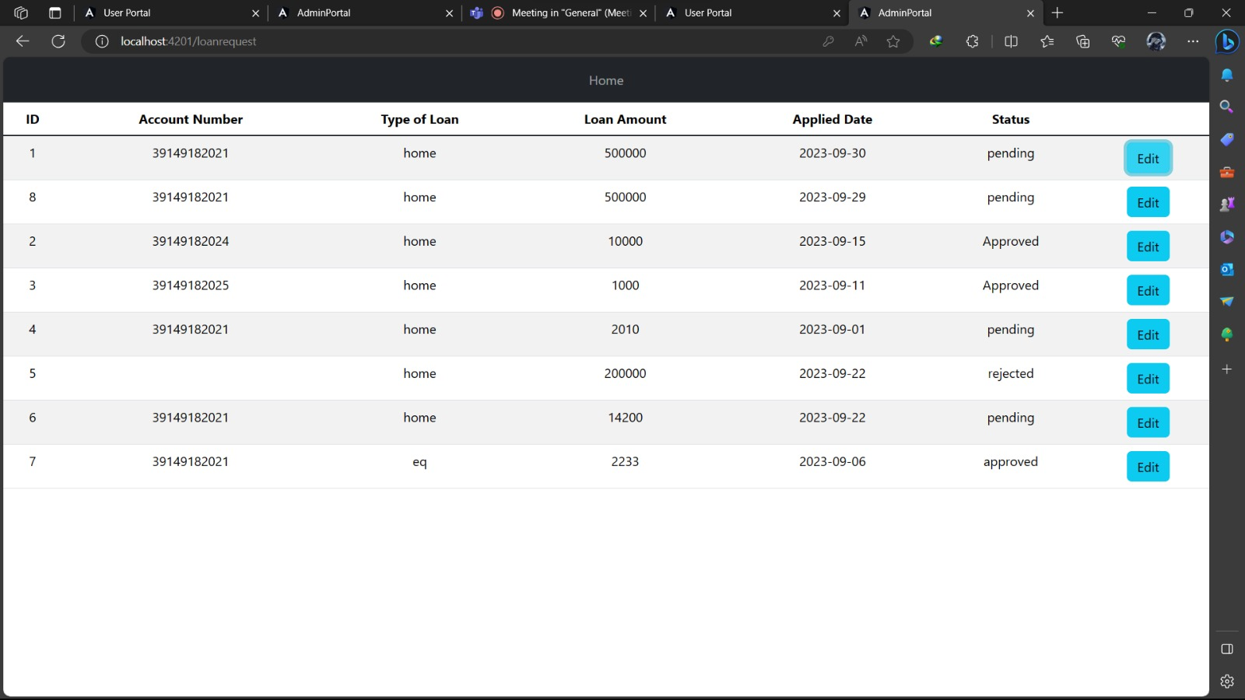
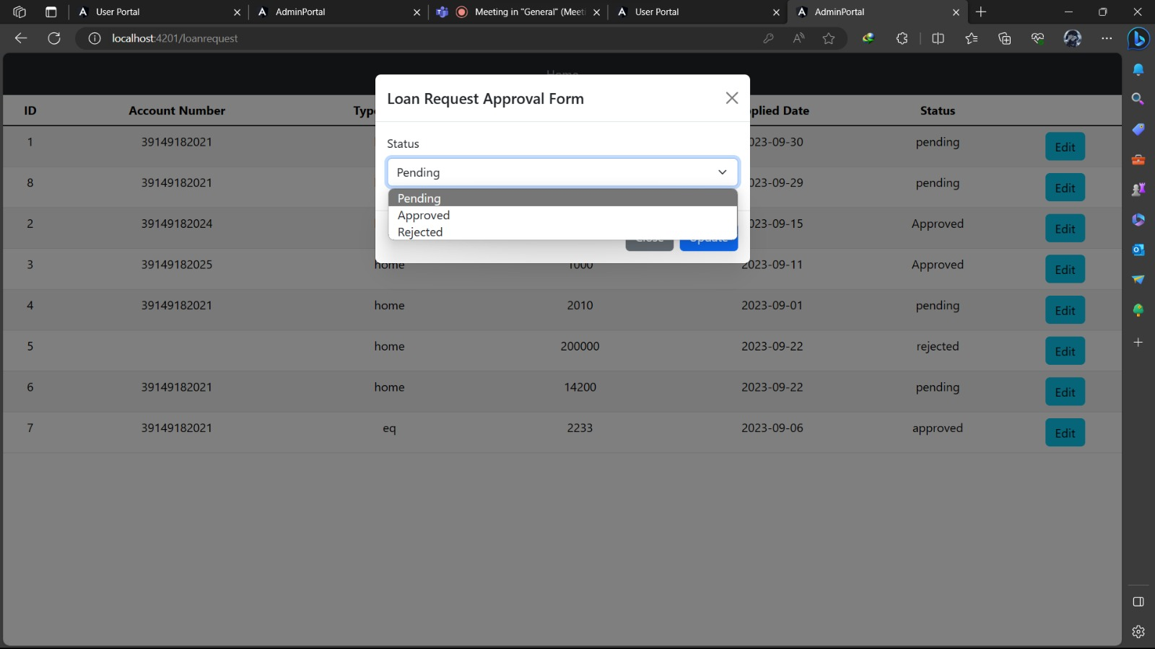

Slide 33
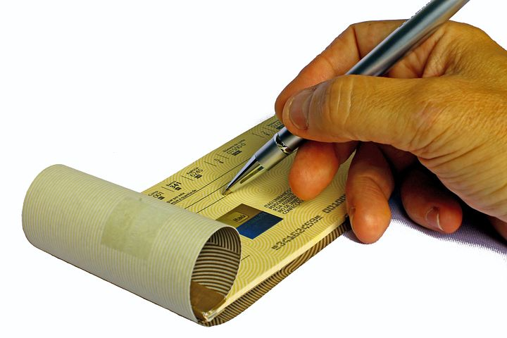
Cheque book request module
To maintain details of requested cheque books and update the status of checks in each issued cheque book, use the ‘Cheque Book Request Detail’ screen.
User can apply for cheque book .
After admin will be Notified and approval the user can get checkbook

Slide 34
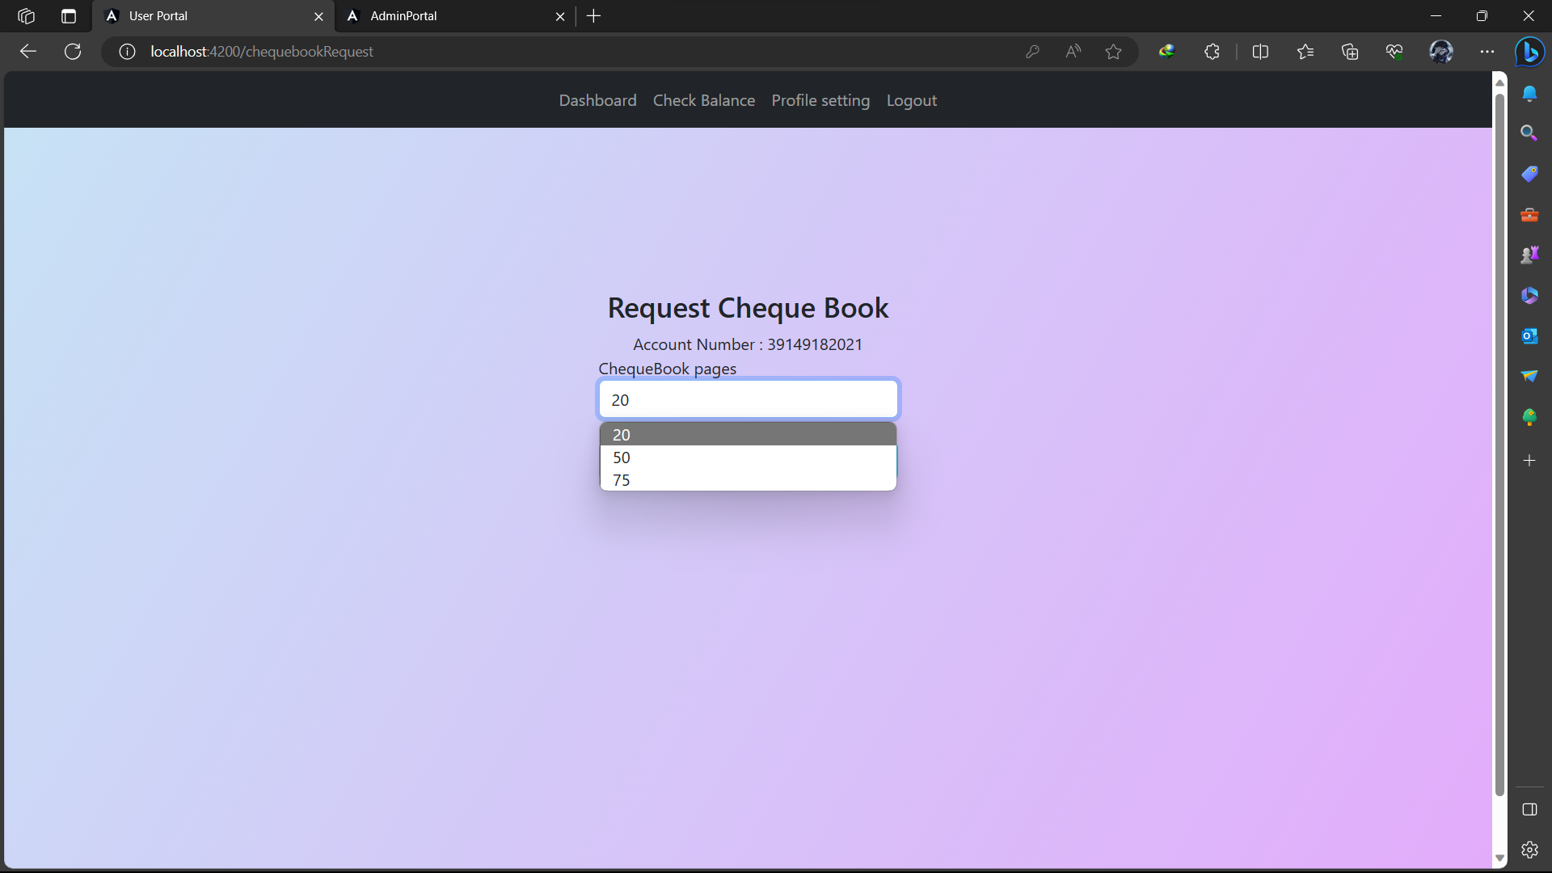
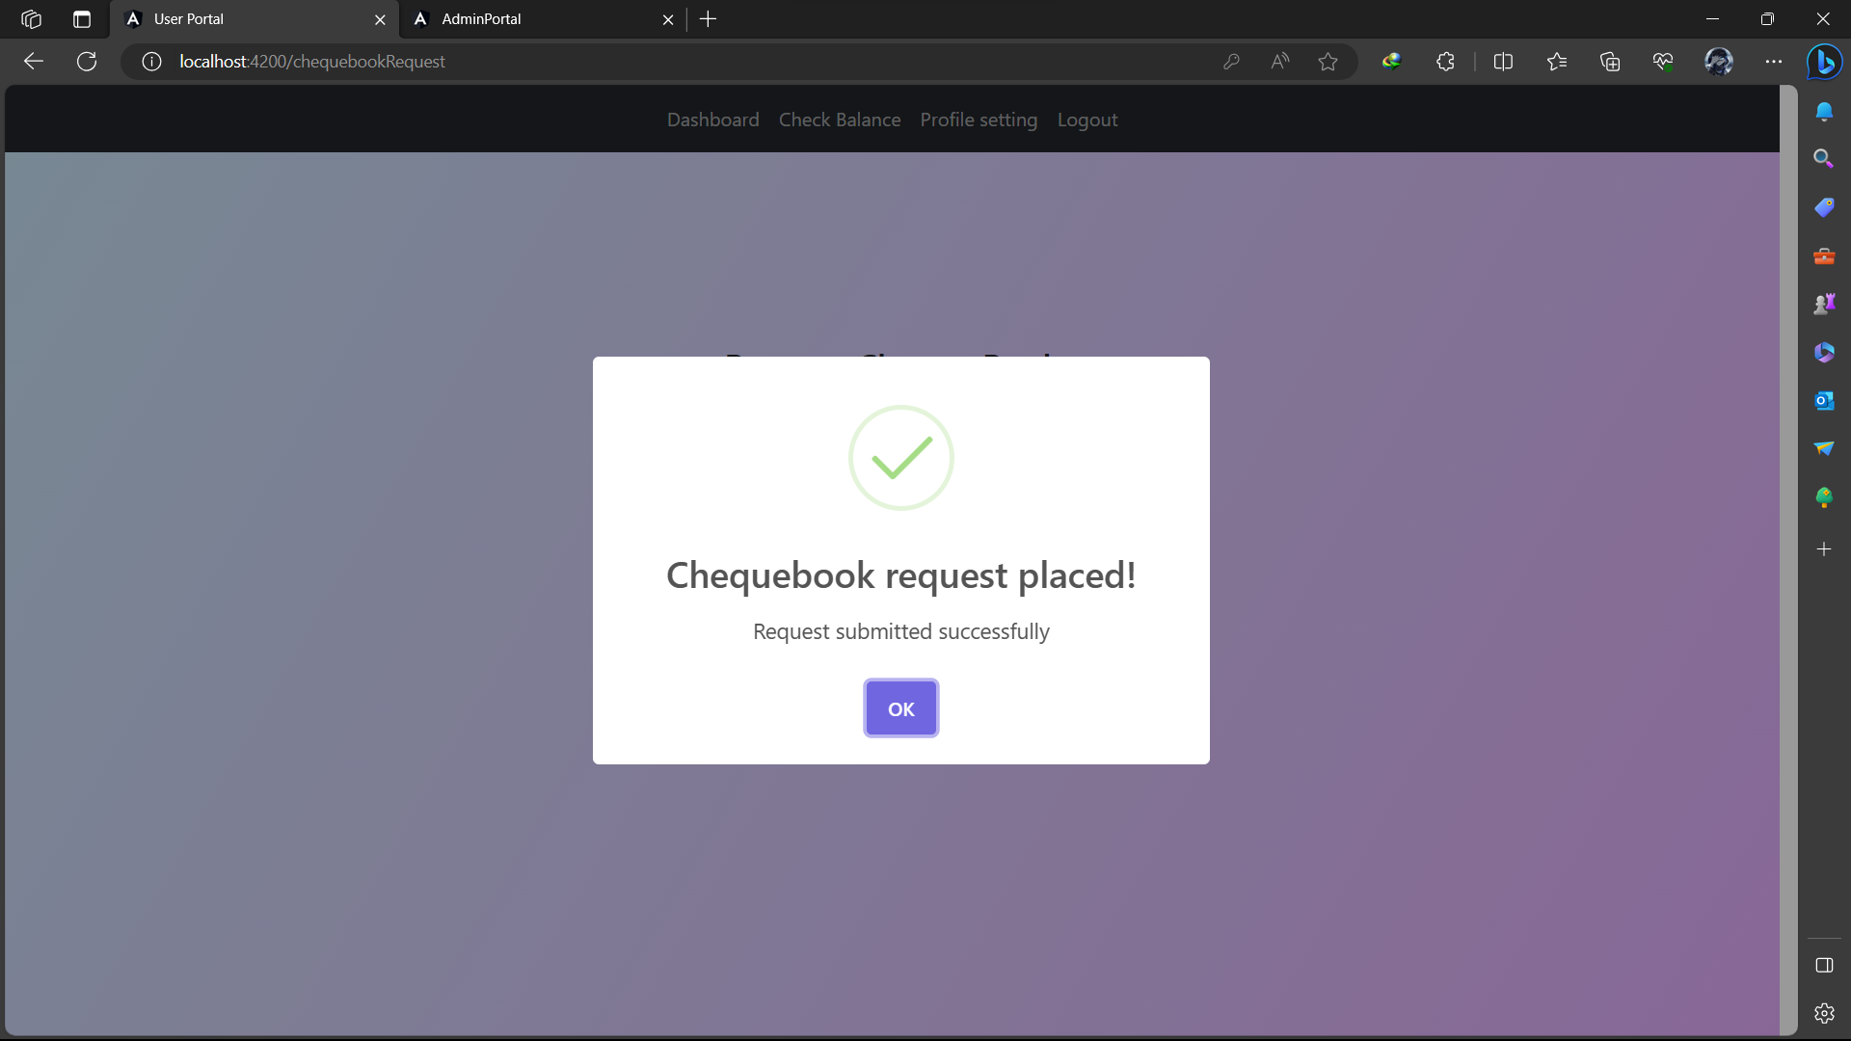

Slide 35
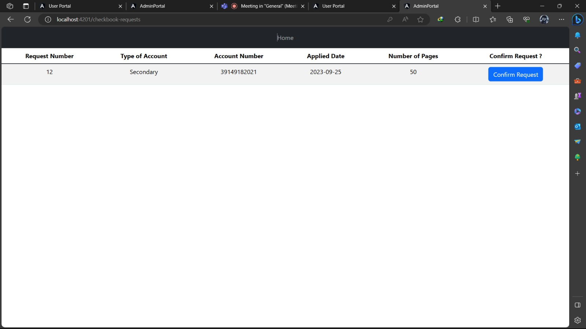

Slide 36
TRANSFER MODULE
You can record a deposit or withdrawal to/from a bank account to keep your balances up-to- date with the activity that happens outside of the accounting software.
As we add accounts and amounts, the Total Deposit/Withdrawal amount will automatically update.
We will be asked to add account number and bank account details after which we can confirm the amount to be deposited or withdrawn.
Click Confirm once all information has been input. Your transaction is now complete.

Slide 37
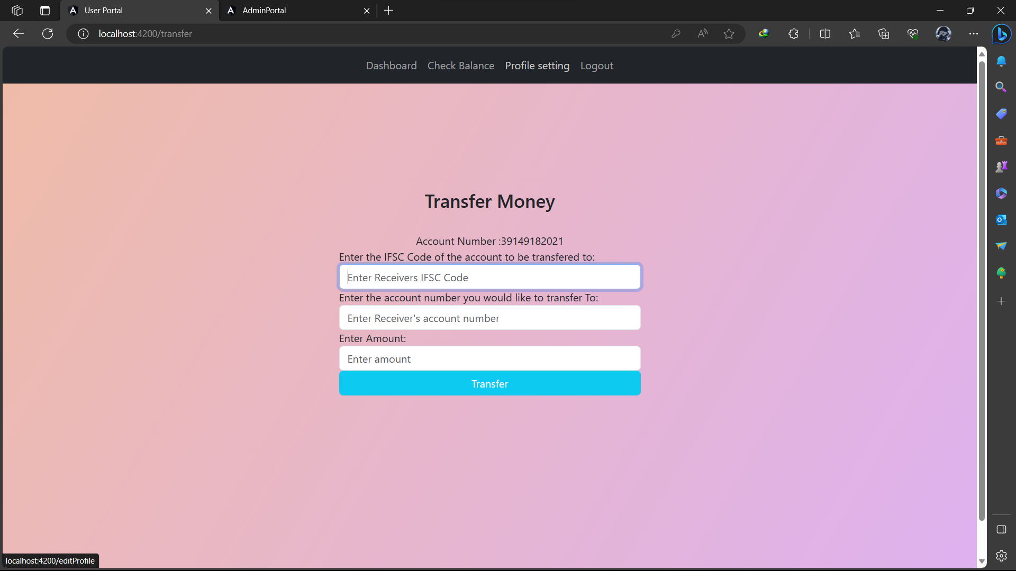
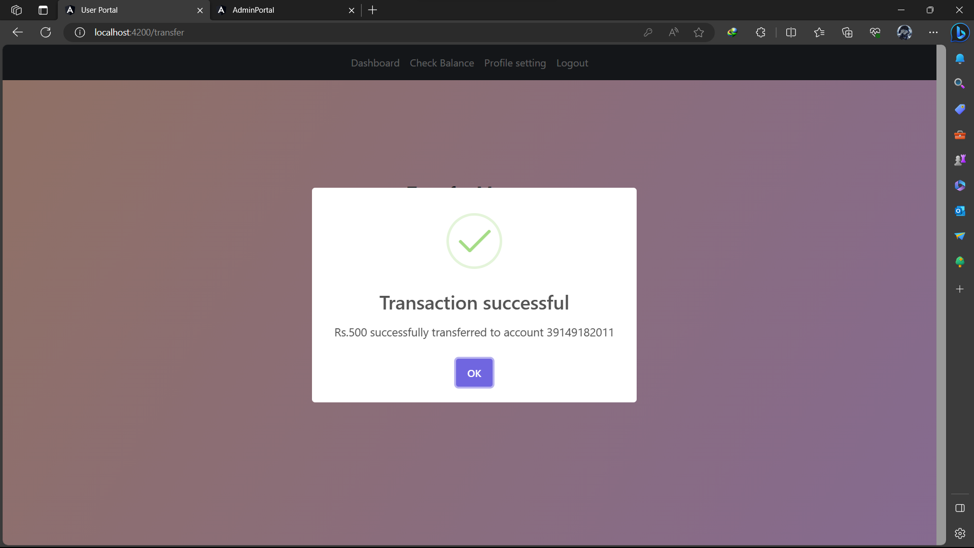

Slide 38
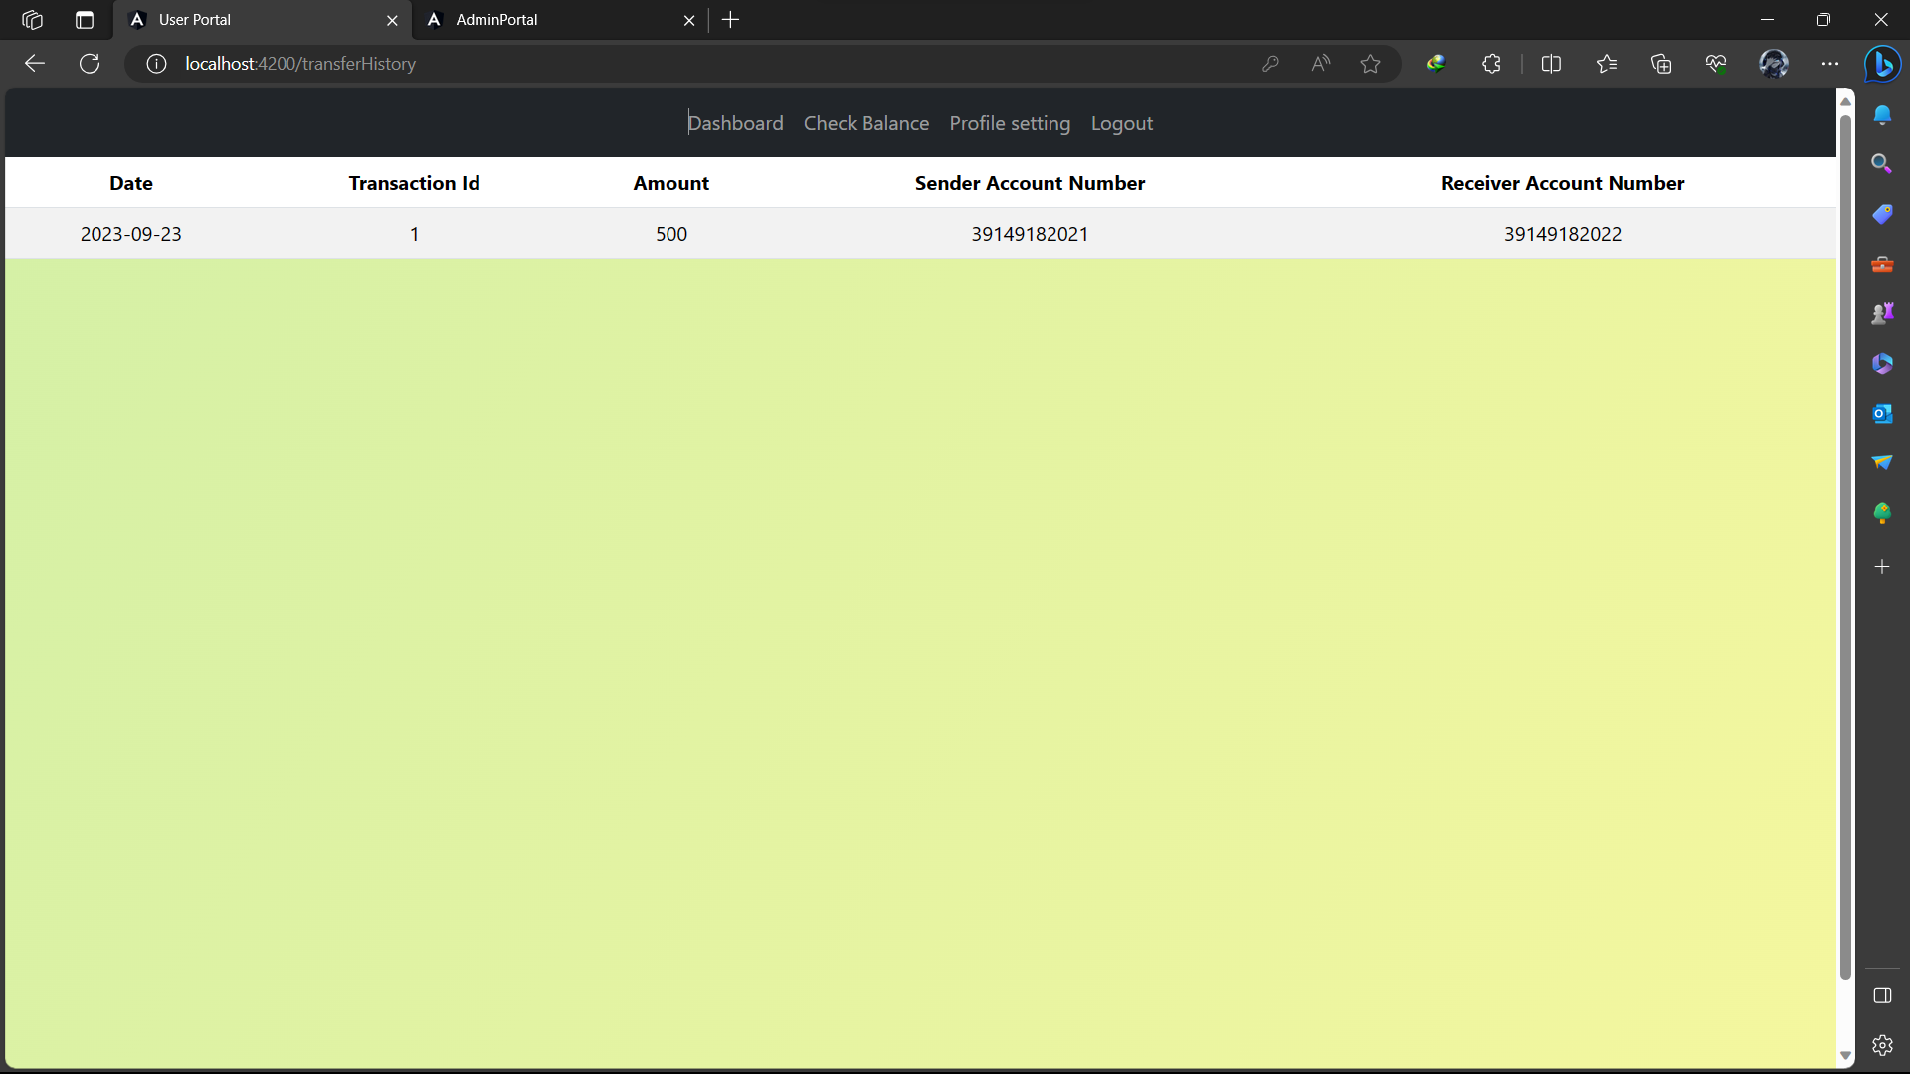
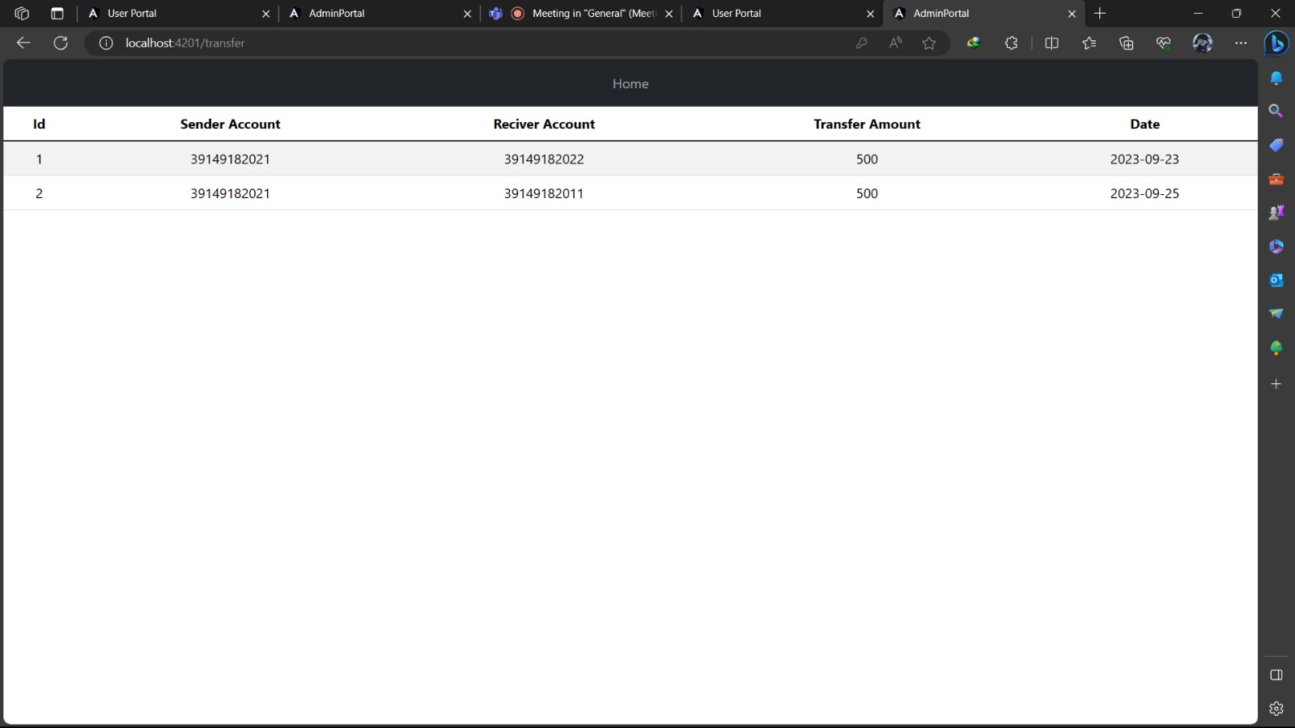
User Transfer history Admin Transfer history

Slide 39
TRANSACTION MODULE
You can record a deposit or withdrawal to/from a bank account to keep your balances up-to- date with the activity that happens outside of the accounting software.
As we add accounts and amounts, the Total Deposit/Withdrawal amount will automatically update.
We can download the transaction history with clicking on download button.

Slide 40
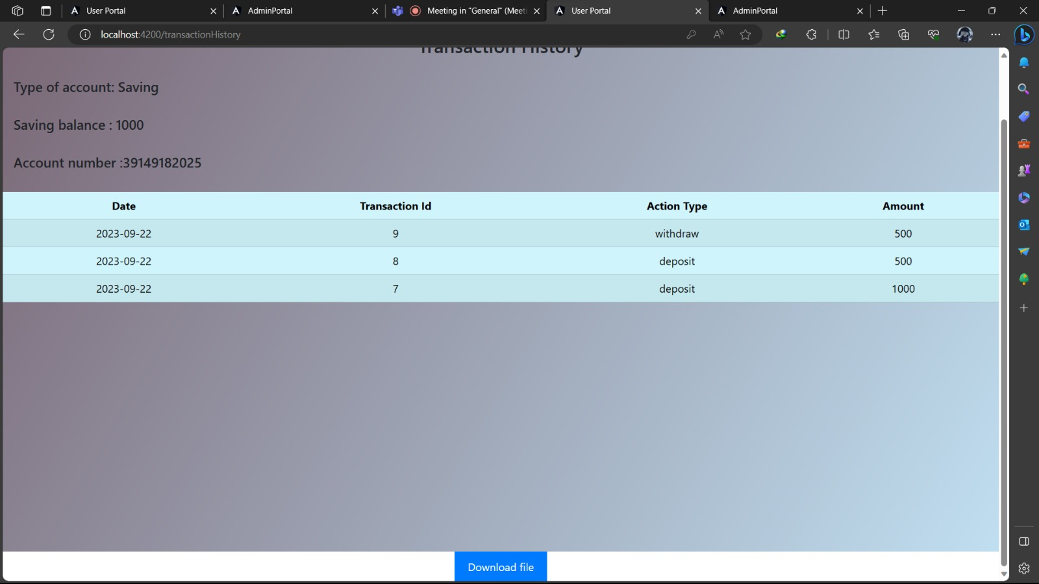
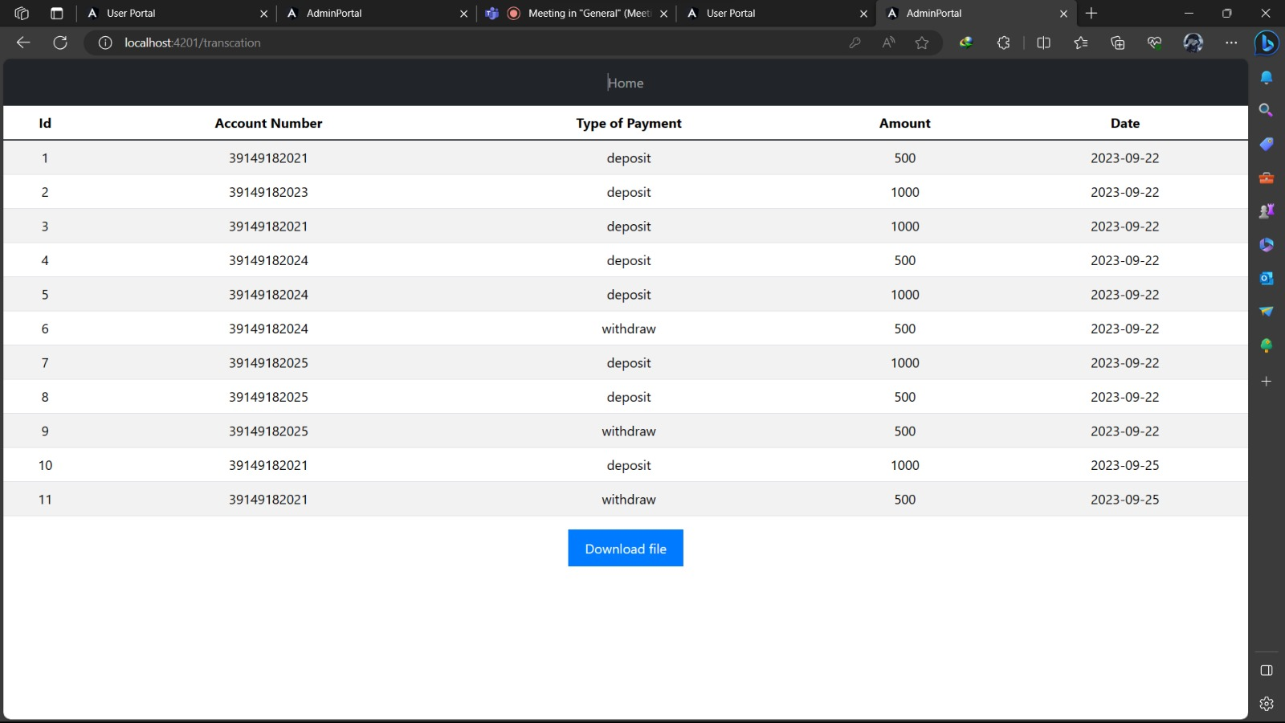
User transaction table Admin transaction table

Slide 41
USER EDIT PROFILE:
Enable users to update their profile information easily.
Editable Fields:
Mobile Number
Address
Email
Old Password
New Password
Benefits:
Convenience for users
Improved data accuracy
Enhanced account security
User-Friendly Interface
Simple and intuitive design
Password strength checks
Security Measures:
Authentication required for changes
Secure password updating

Slide 42
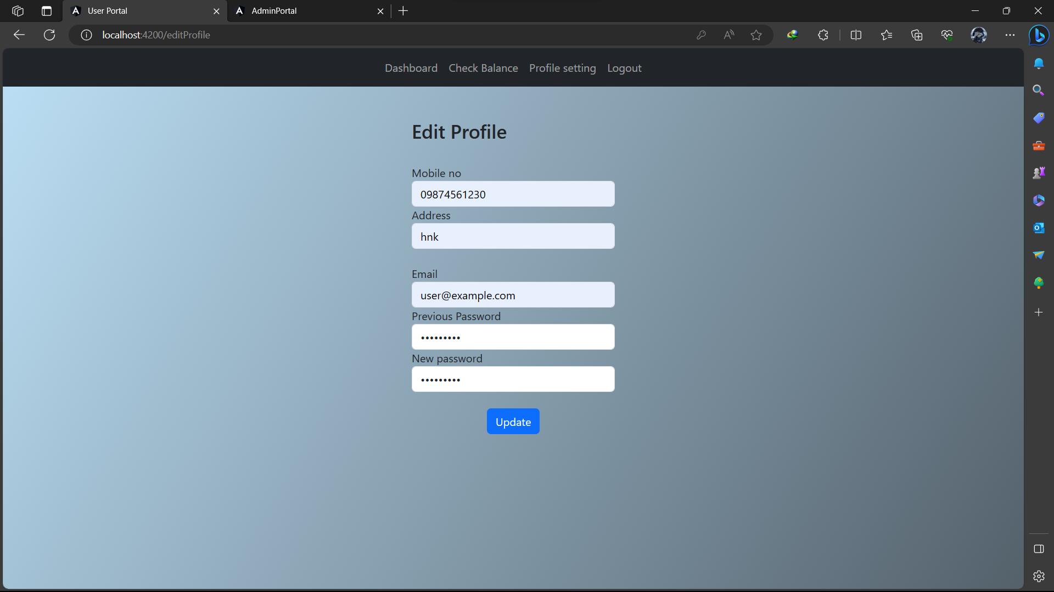
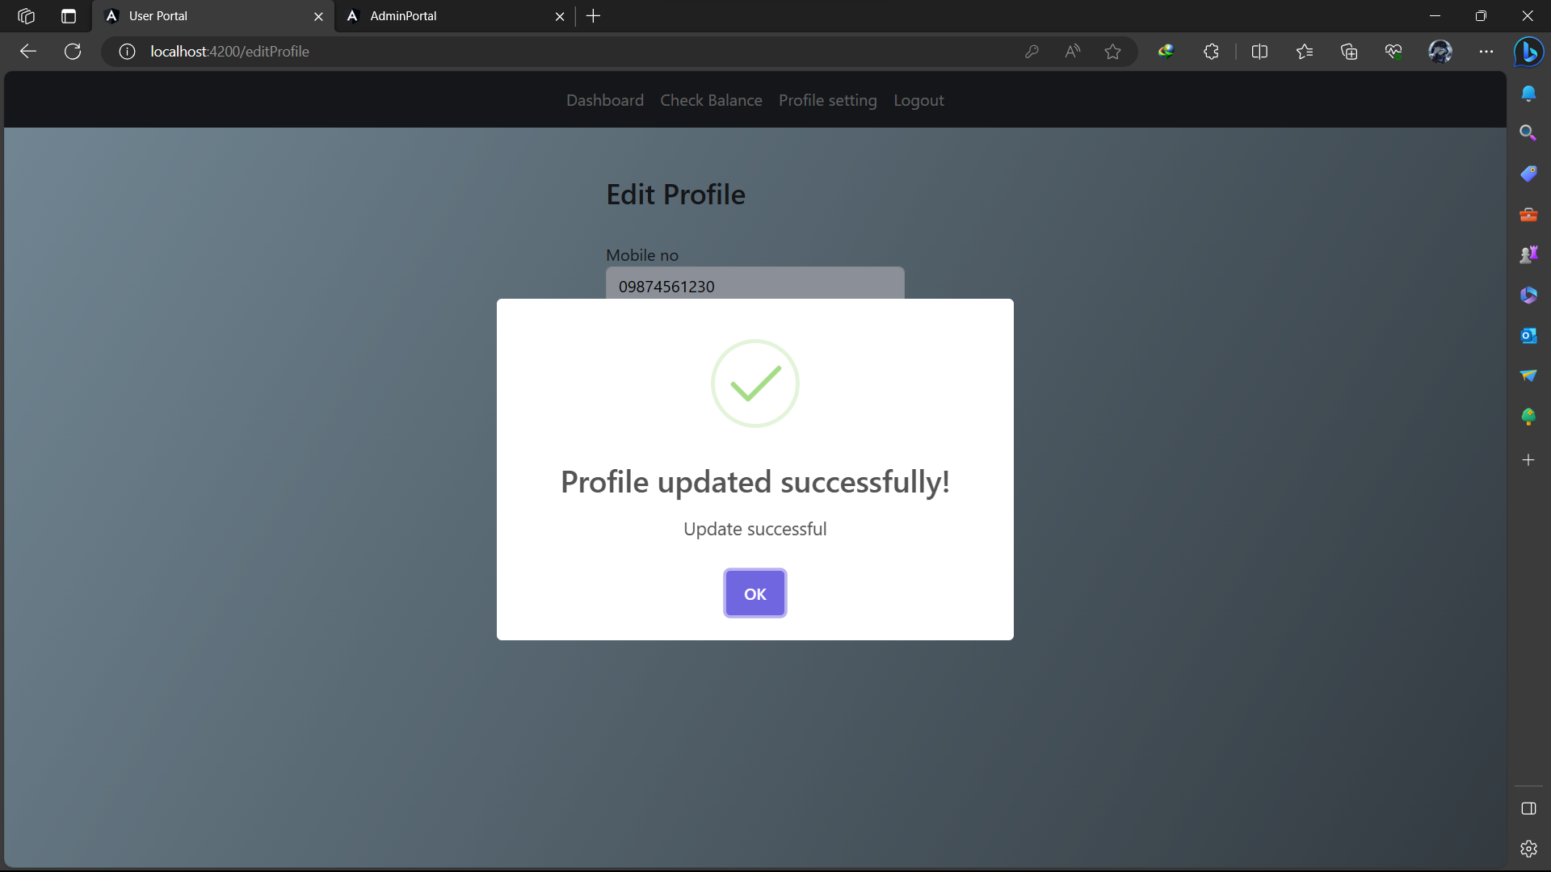

Slide 43
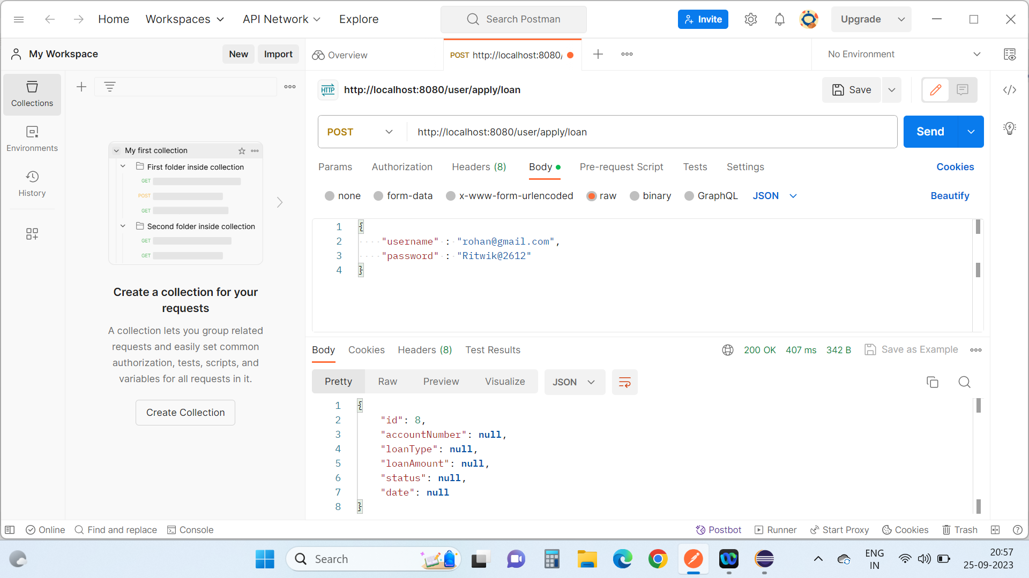
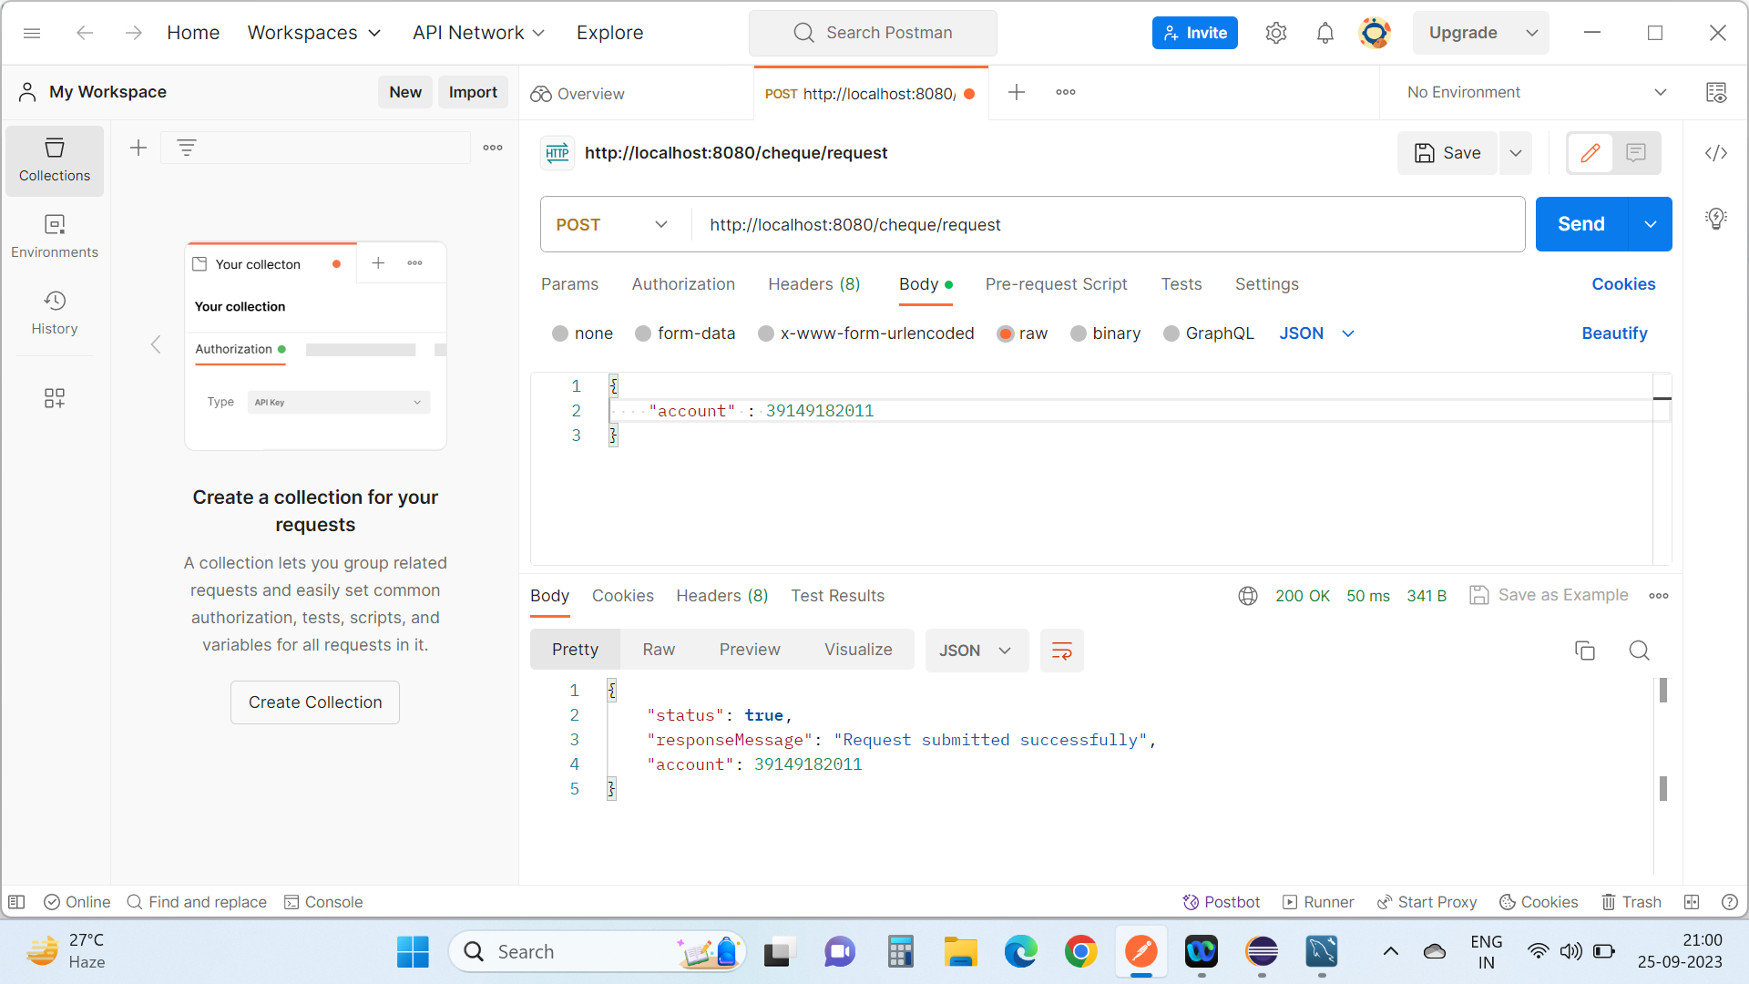
Functional Testing

Slide 44
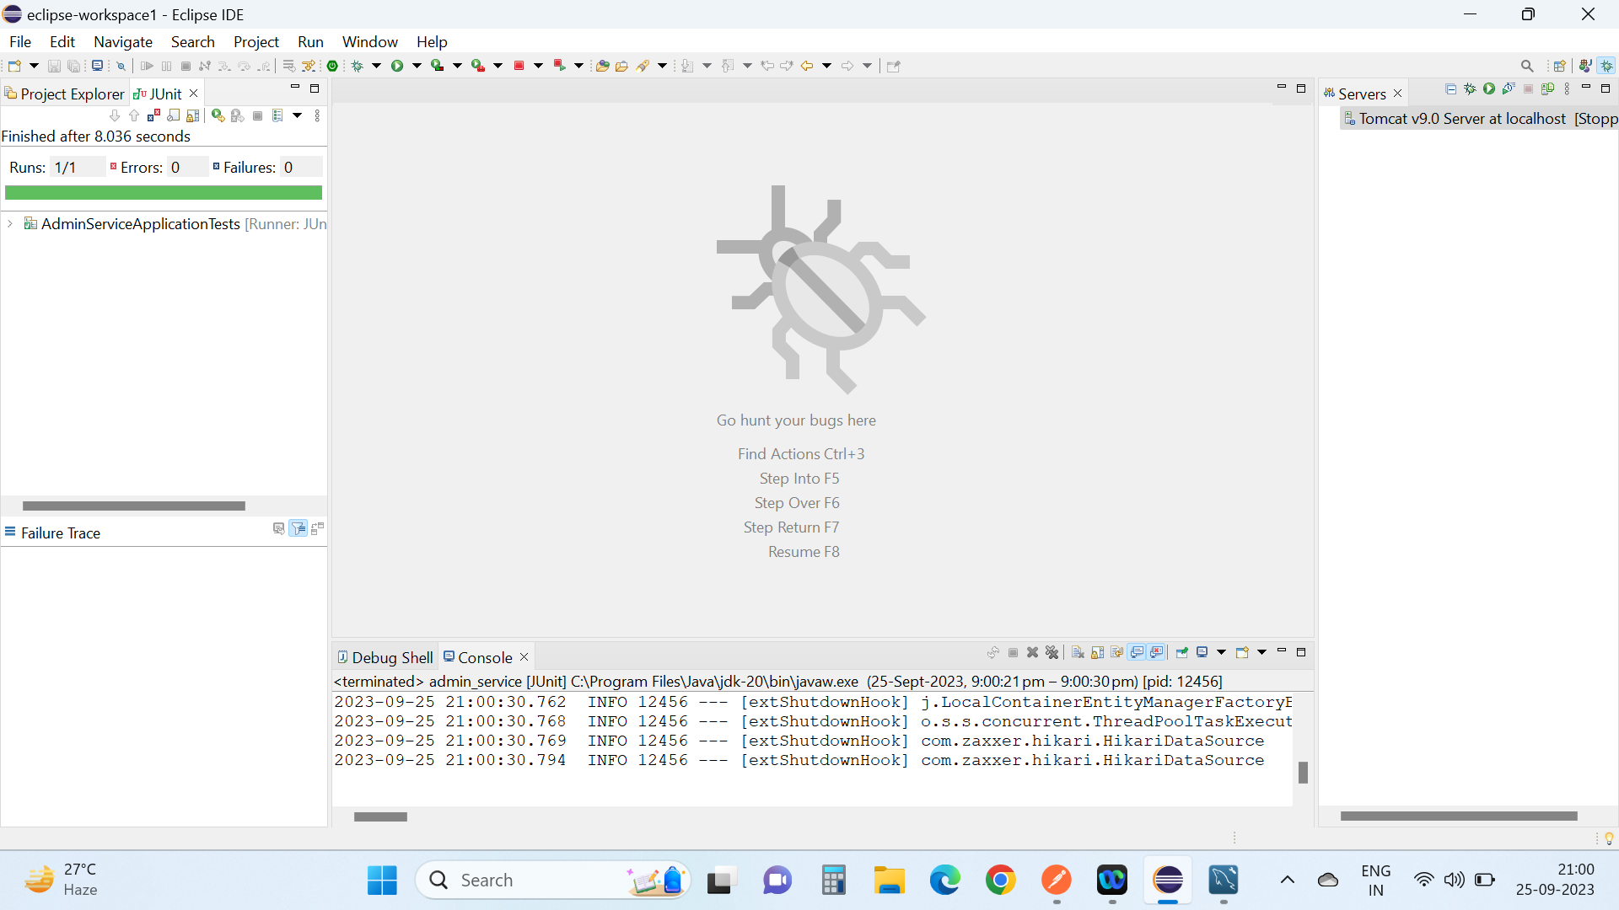
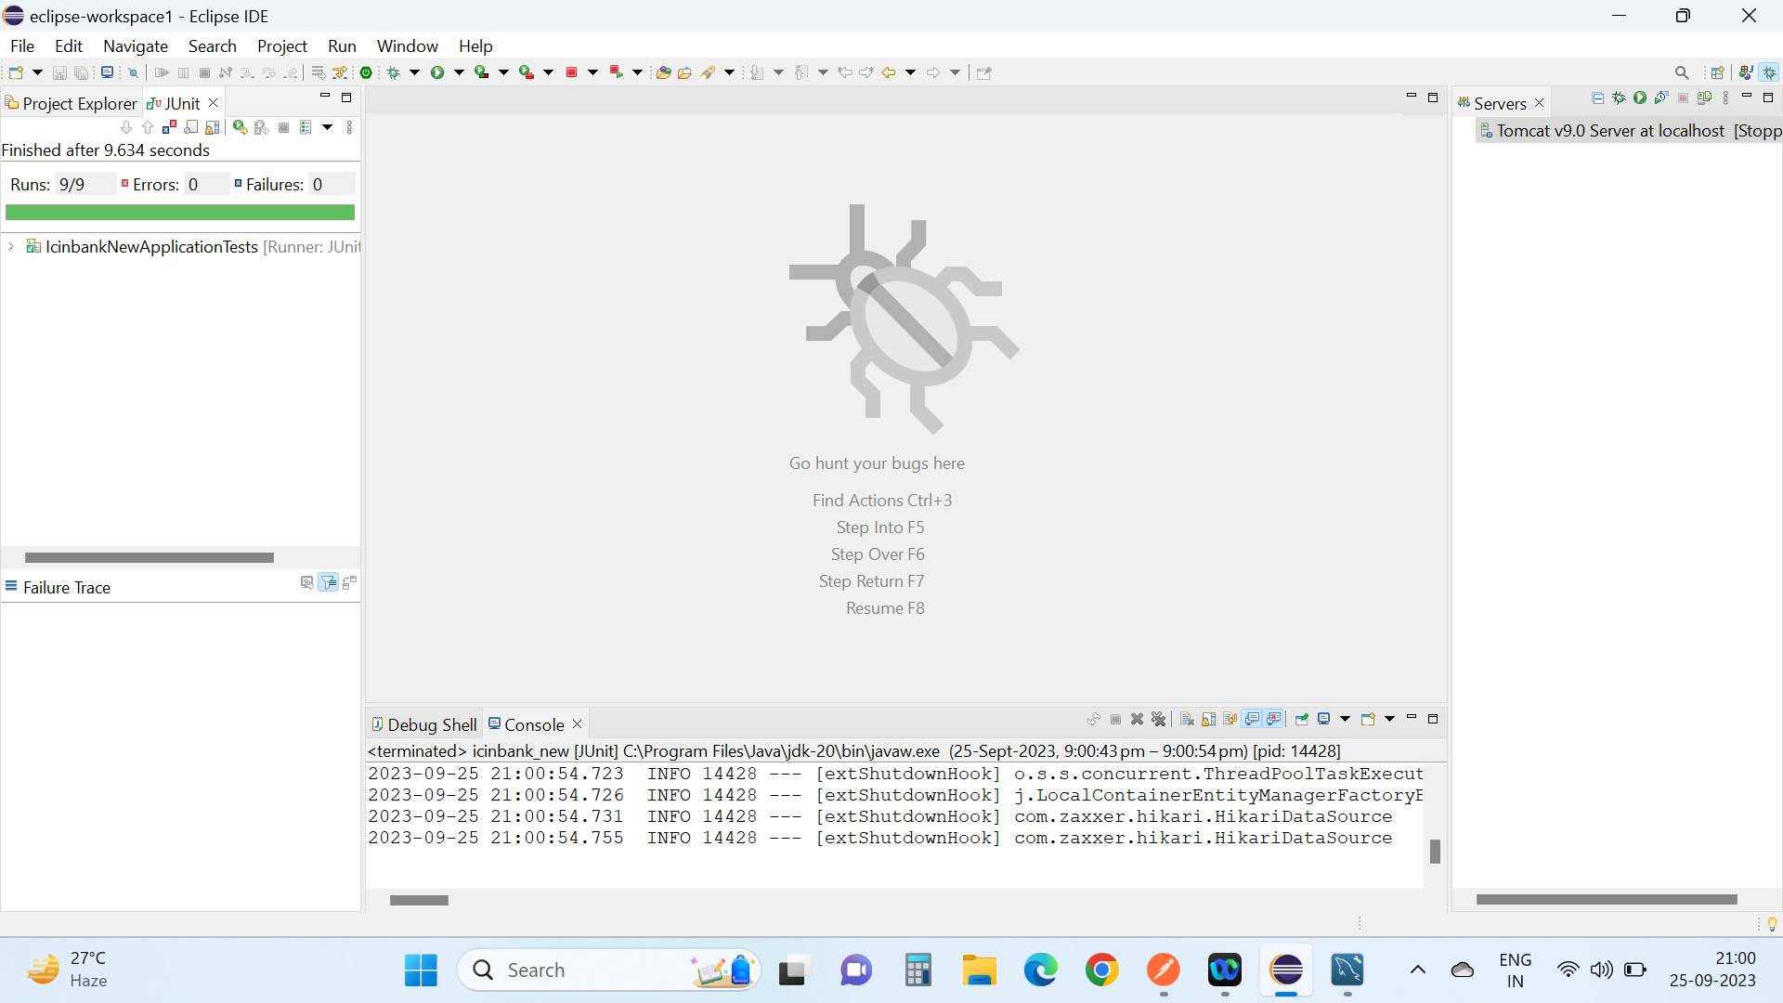
JUNIT

Slide 45
CONCLUSION
Successful development and launch of the Online Banking Portal.
Comprehensive feature set, including account management, transactions, and more.
Robust security measures in place, ensuring customer data protection.
Scalability and performance to meet growing demands.

Slide 46
THANK YOU

